Slide 1


Slide 2
Sample Road – December City Input
Preference is NO Guardrail
  Aesthetics
  Long term maintenance
Prefer FDOT Barrier wall system
Prefer lower profile barrier for flare outs
Open to Raised Sidewalk or Barrier Separated
Bike Lanes not desired at time of construction
  Grant Funding

Slide 3
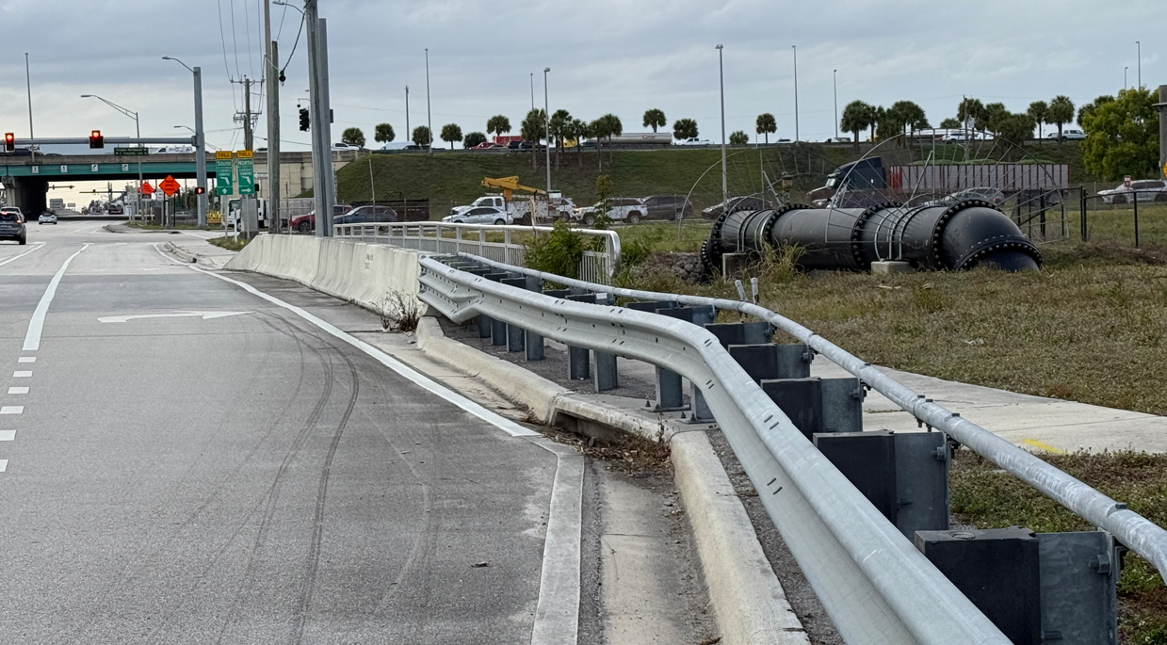
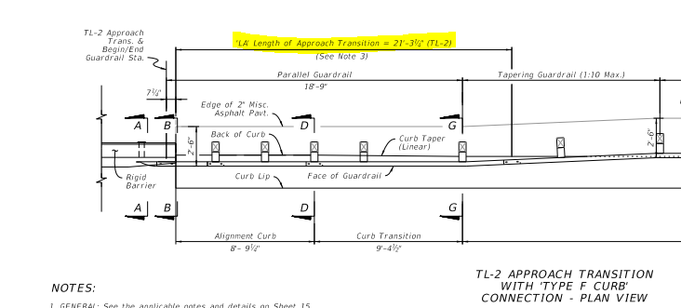
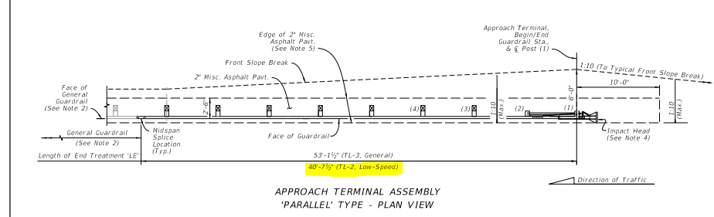
Sample Road – No Guardrail
Guardrail has poor aesthetics
Standard guardrail attachment is ~62’
Guardrail will be substandard to maintain driveway access

Slide 4
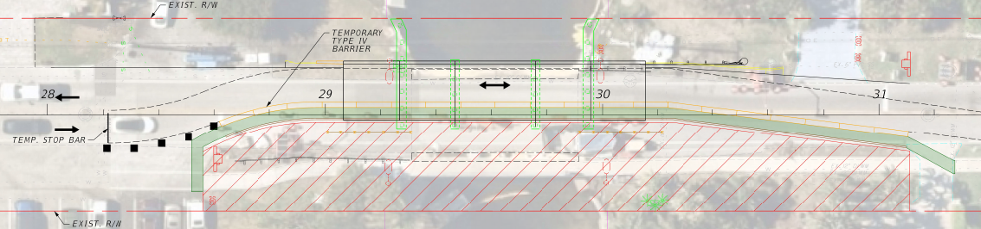
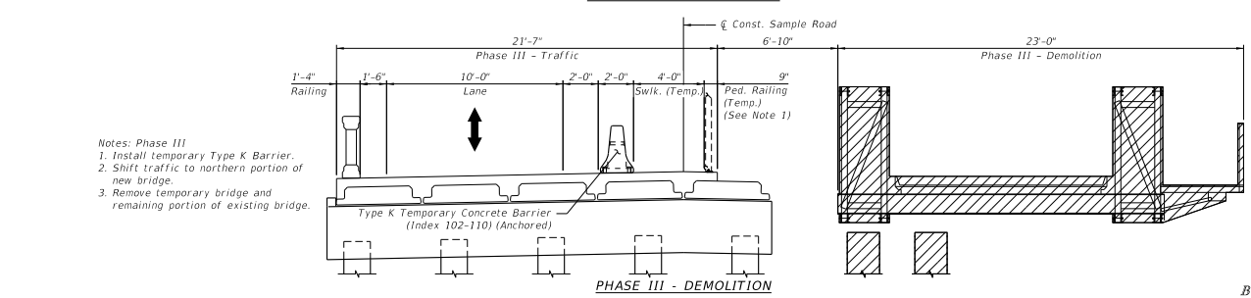
Sample Road – Shoulder Width
The 6-foot widened shoulder is needed to Phase construct the Bridge

Slide 5
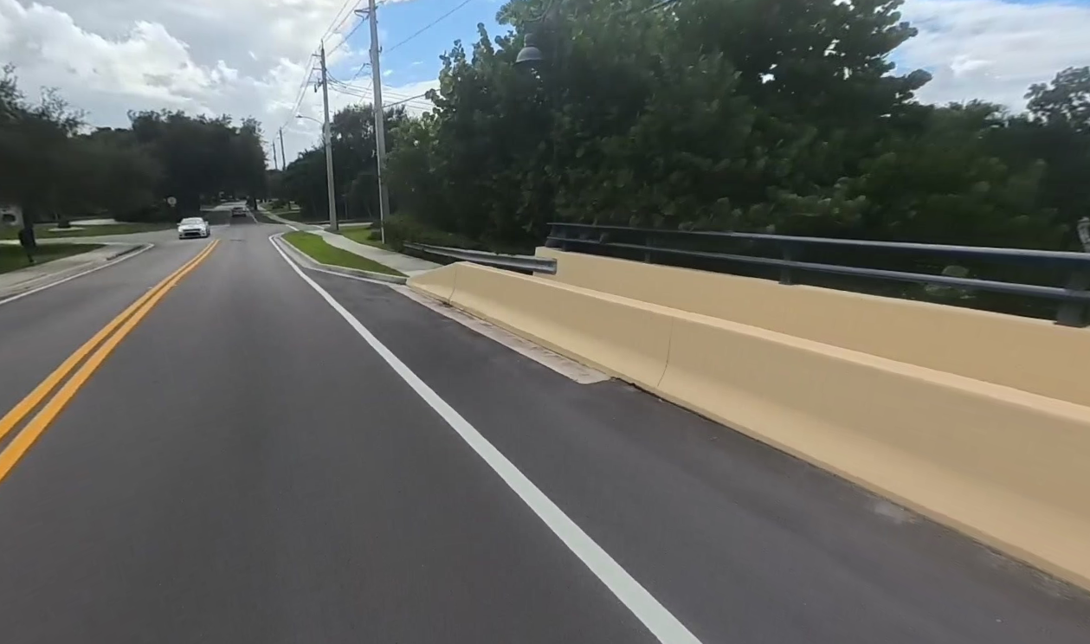
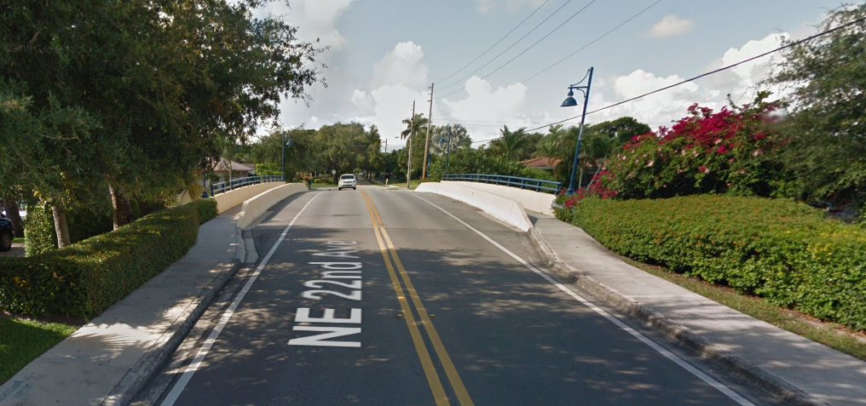
January Commission Input
Preference towards raised sidewalk
Reduce roadway pavement width
  Traffic calming effect
  No passing vehicles
Bridge with more neighborhood feel
  No Guardrail
  Aesthetics
Lighthouse Drive over North Grand Canal
Lighthouse Drive over North Grand Canal (Narrowing of approach roadway)

Slide 6
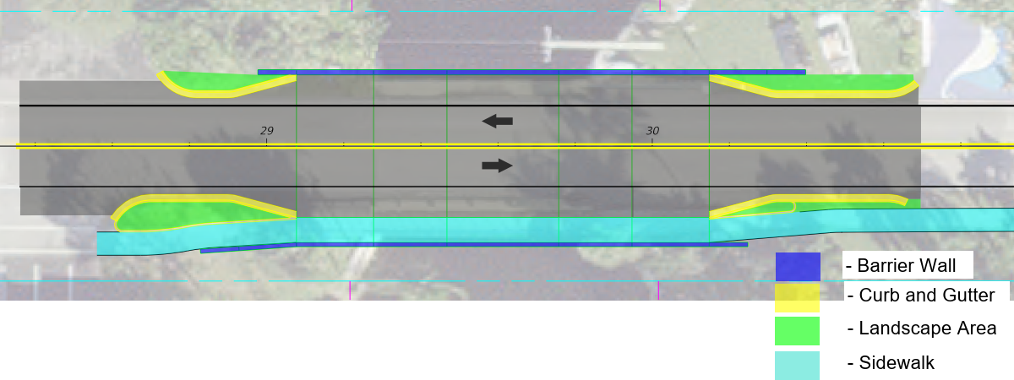
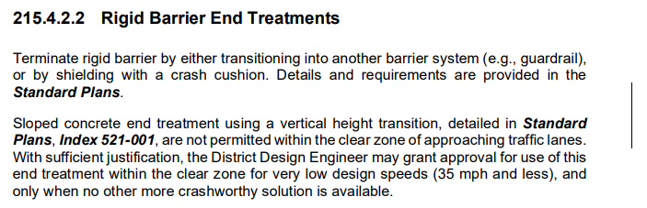
Sample Road – Straight Barrier
Raised Sidewalk
Design to accommodate future flexibility
Straight barrier ends meet current Clear Zone requirements behind curb
Provides space for plantings
Reduces approach roadway width (Traffic Calming effect)

Slide 7
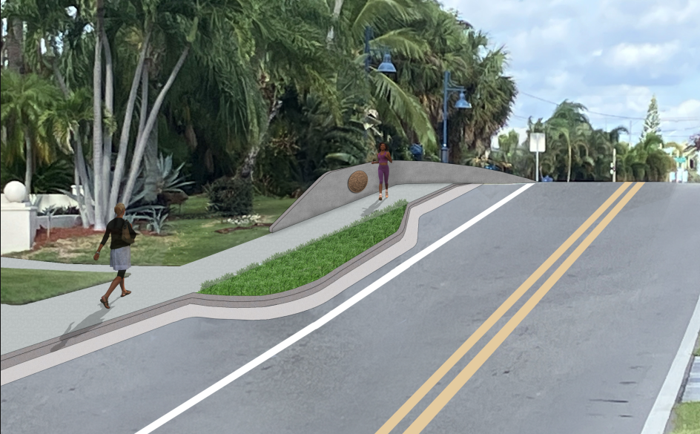
Sample Road – Straight Barrier

Slide 8
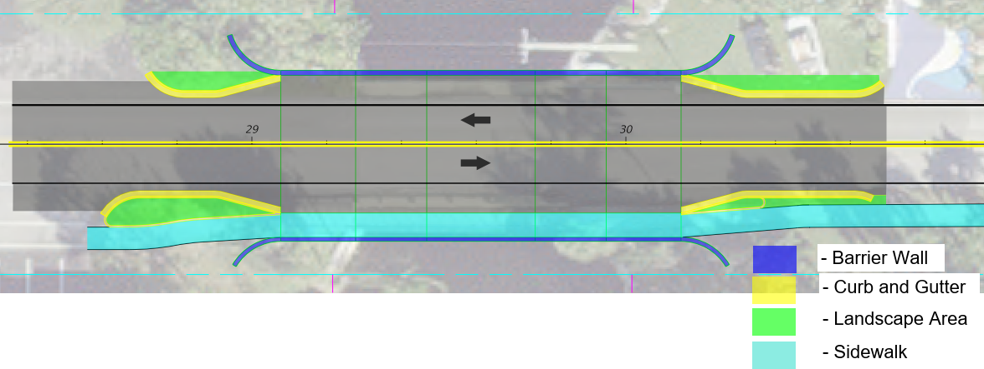
Sample Road – Flared Barrier
Raised Sidewalk
Design to accommodate future flexibility
Flared barrier ends meet current Clear Zone requirements behind curb
Provides space for plantings
Reduces approach roadway width (Traffic Calming effect)

Slide 9
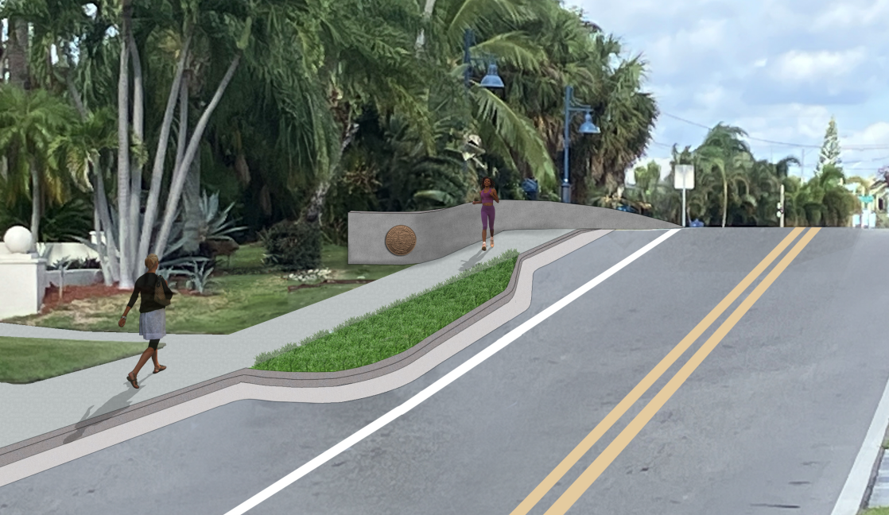
Sample Road – Flared Barrier
Existing Bridge Drainage

Slide 10
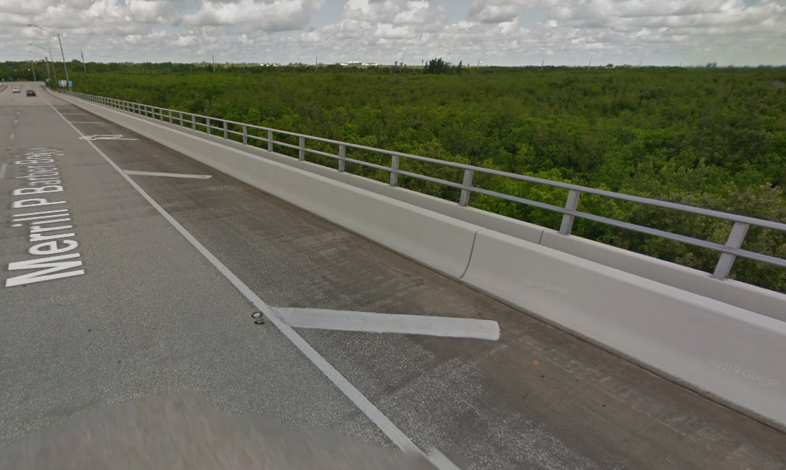
Shoulder Marking Options
No shoulder striping
Chevron shoulder striping
Overhead Utilities
Stormwater Discharge
Lighthouse Drive over North Grand Canal
SR 60 in Vero Beach– Stiped out

Slide 11
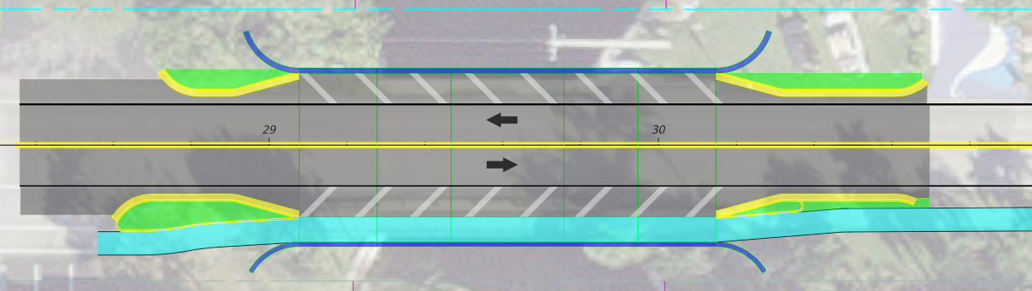
Shoulder Marking Options
Overhead Utilities
Stormwater Discharge

Slide 12
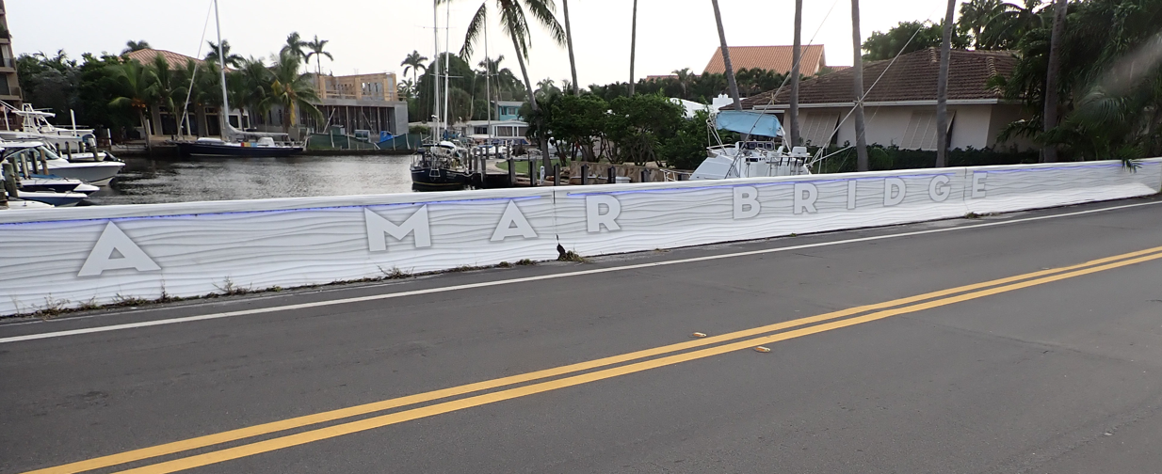
FDOT Traffic Railing Aesthetic Options
Terra Mar Bridge – Pompano
  Aesthetic Paint Coating
  LED Down lighting

Slide 13
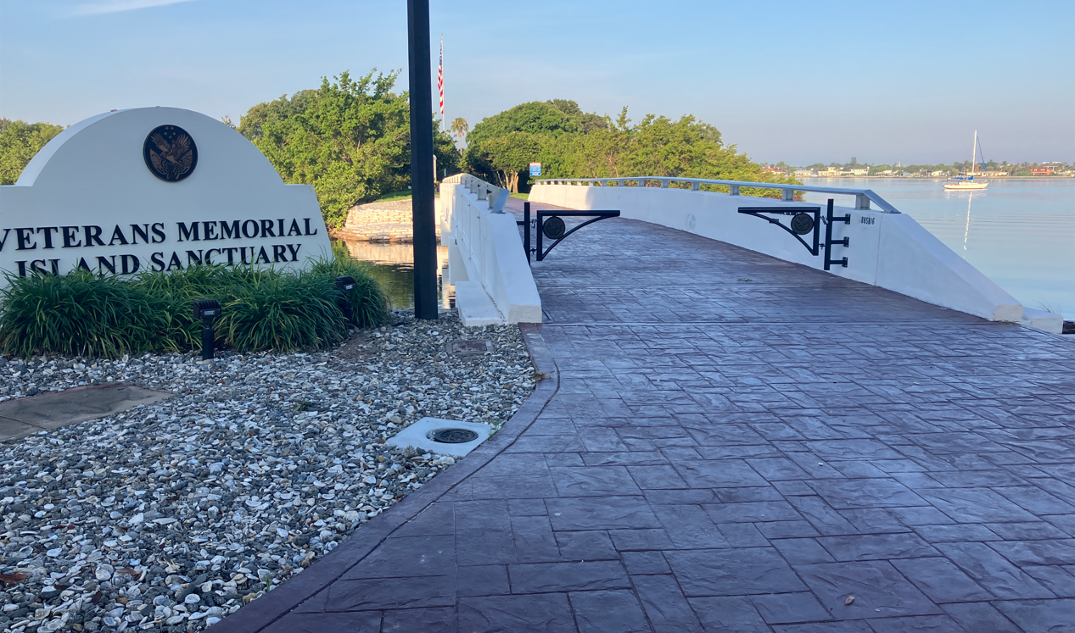
Textured Sidewalk Treatments
Memorial Island Bridge – Vero Beach
  Stamped Colored concrete sidewalk

Slide 14

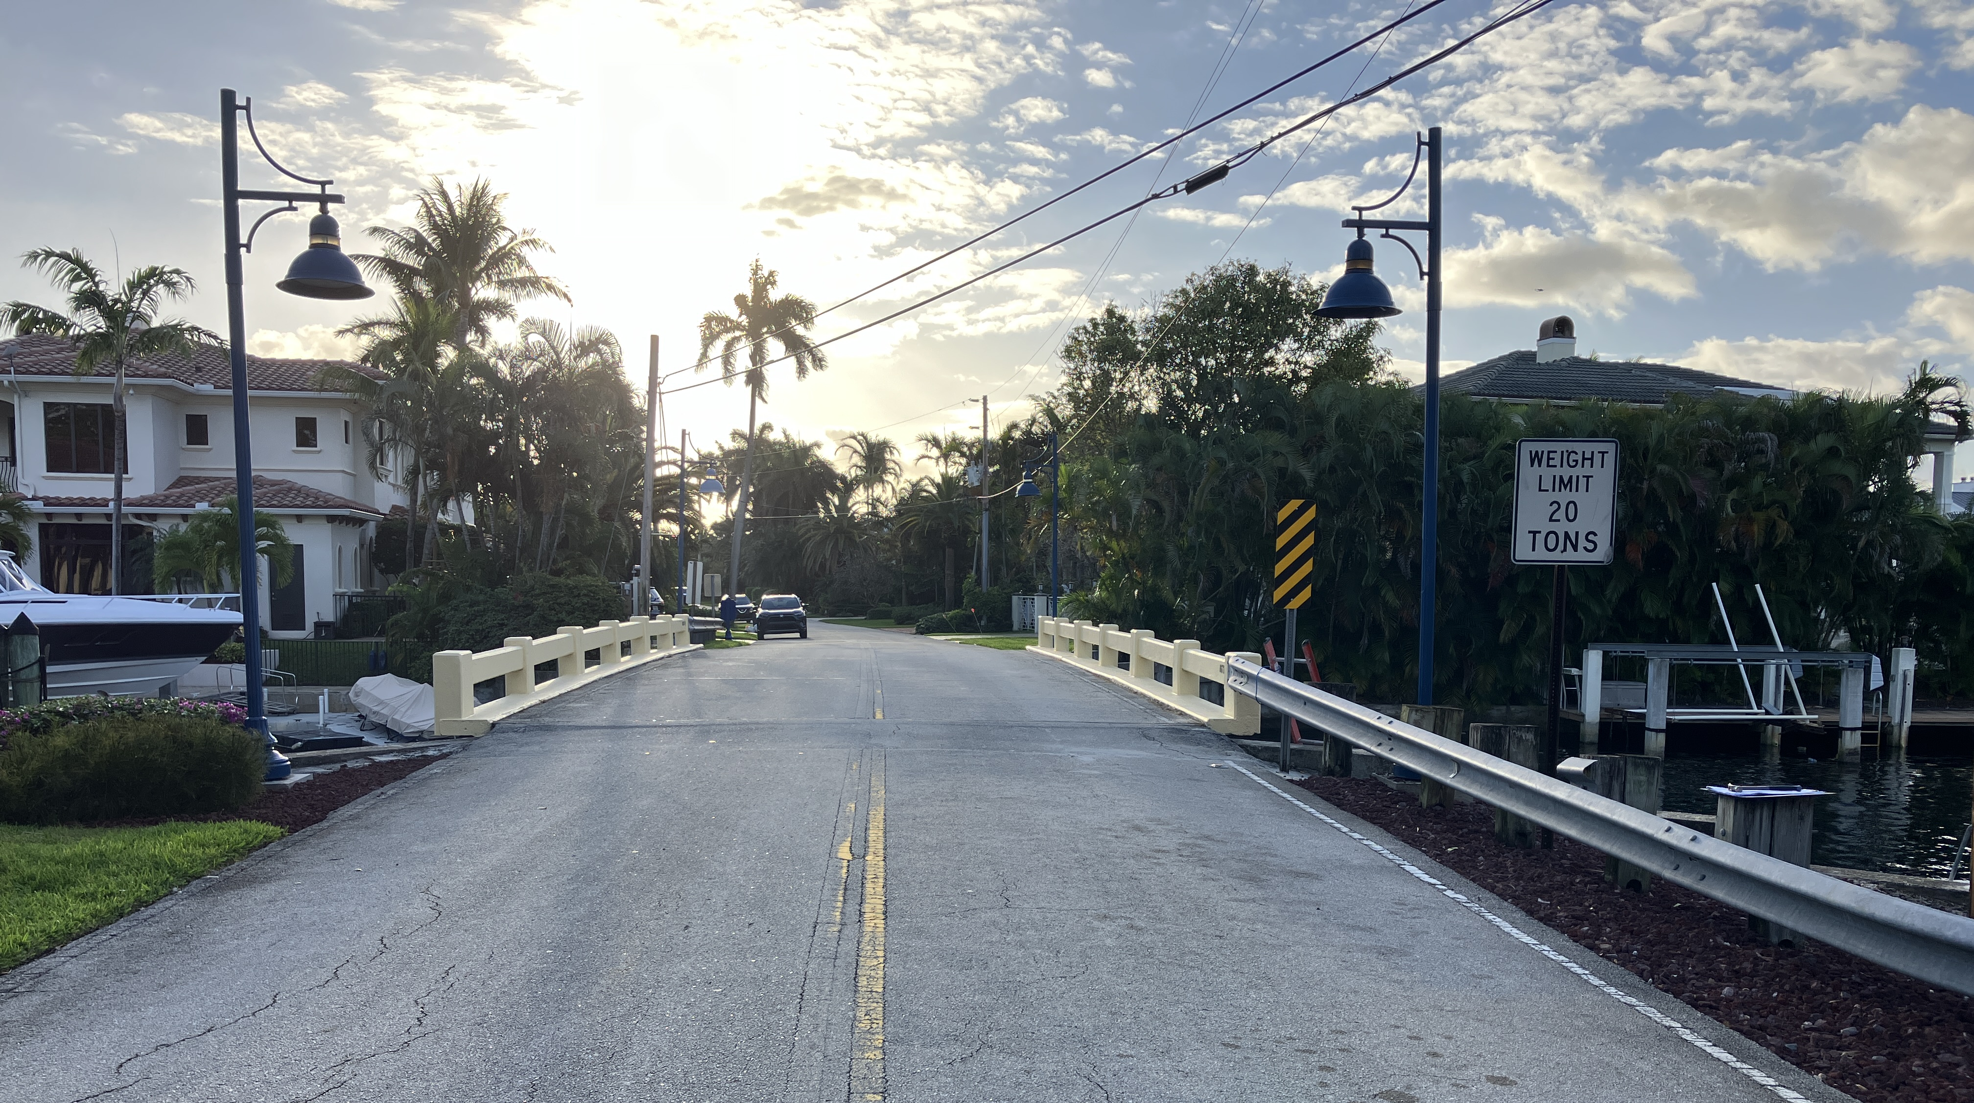
Questions?
Requested Input from Commission
  Input on Shown Options
  Straight vs Flare out Barrier Ends
14

