Slide 1


Slide 2
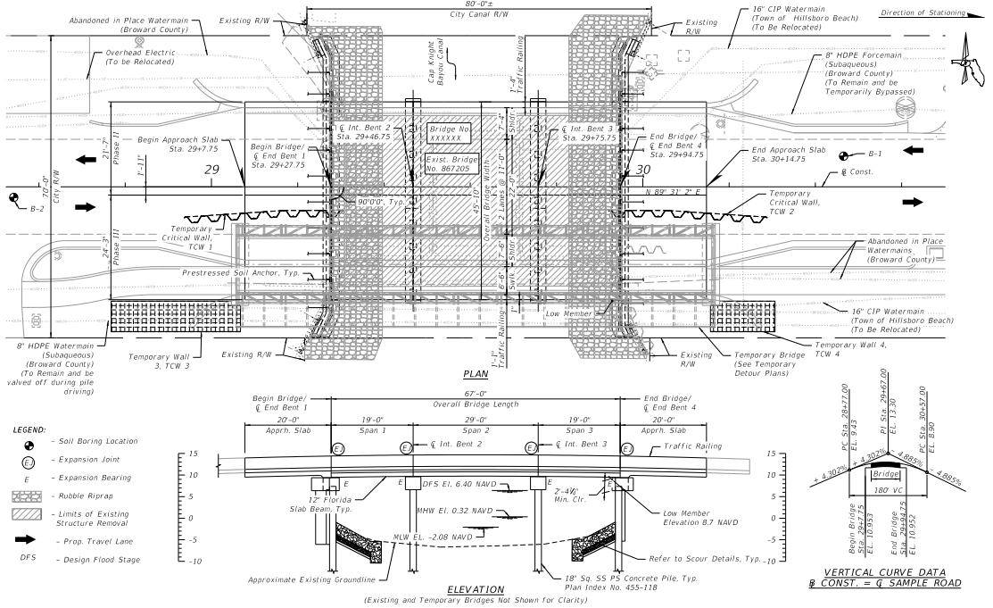
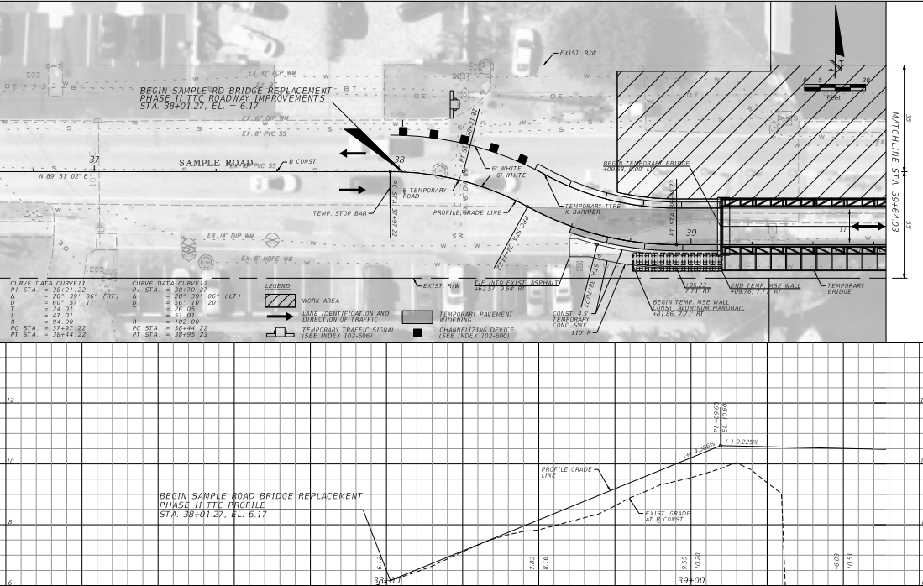
Update on Design Progress
Initial Design Phase (30%) Completed
Submitted both projects to FDOT
Received minor comments on NE 31st Court
Sample Road currently in FDOT review
Initial Design
Design project geometry (Roadway and Bridge)
Bridge Hydraulics Study
Environmental Assessment

Slide 3
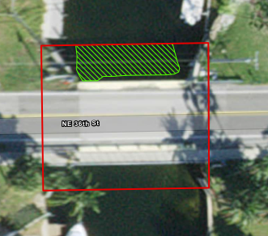
Initial Design Highlights
Tasks after Initial
Performed Seagrass Survey
Submitted US Army Corps of Engineers Permit Applications
Long lead time
Starting into Utility design
Preliminary design and cost for Hillsboro Watermain relocation
Starting into design of Broward County Utility relocations
Preliminary coordination with future Broward County Raw water project
Next Steps
Public Outreach
Continue into Final Design

Slide 4
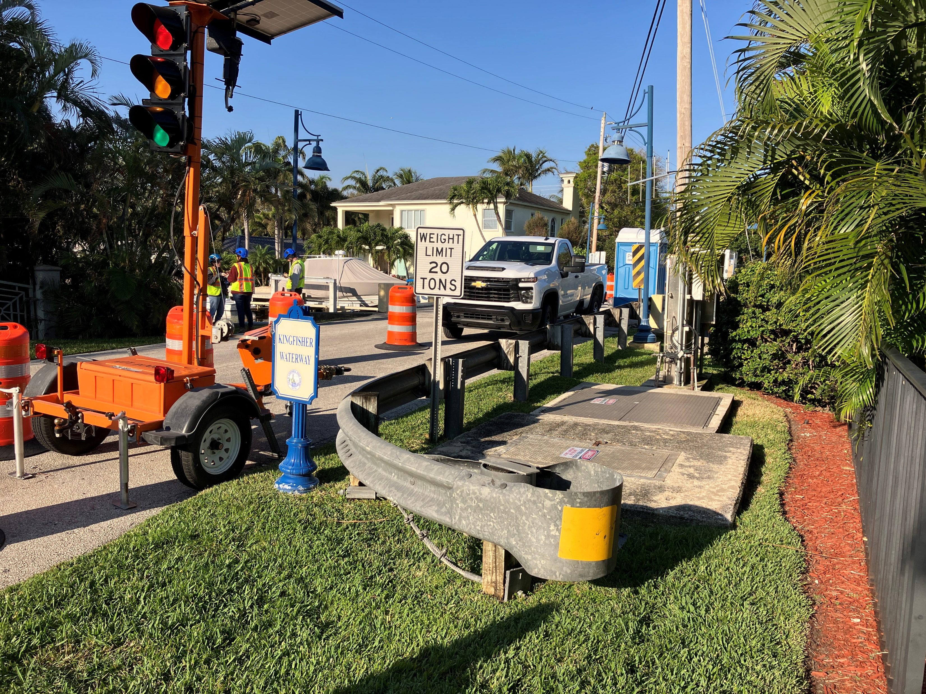
NE 31st Court – Design Highlights
Utilize Temporary Bridge to maintain a single lane of access
Connect to adjacent seawalls within City Roadway & Canal R/W
Avoid conflicts with BC Lift Station
Increasing vertical clearance under the bridge
Minimize traffic impacts to Lighthouse Drive through construction

Slide 5
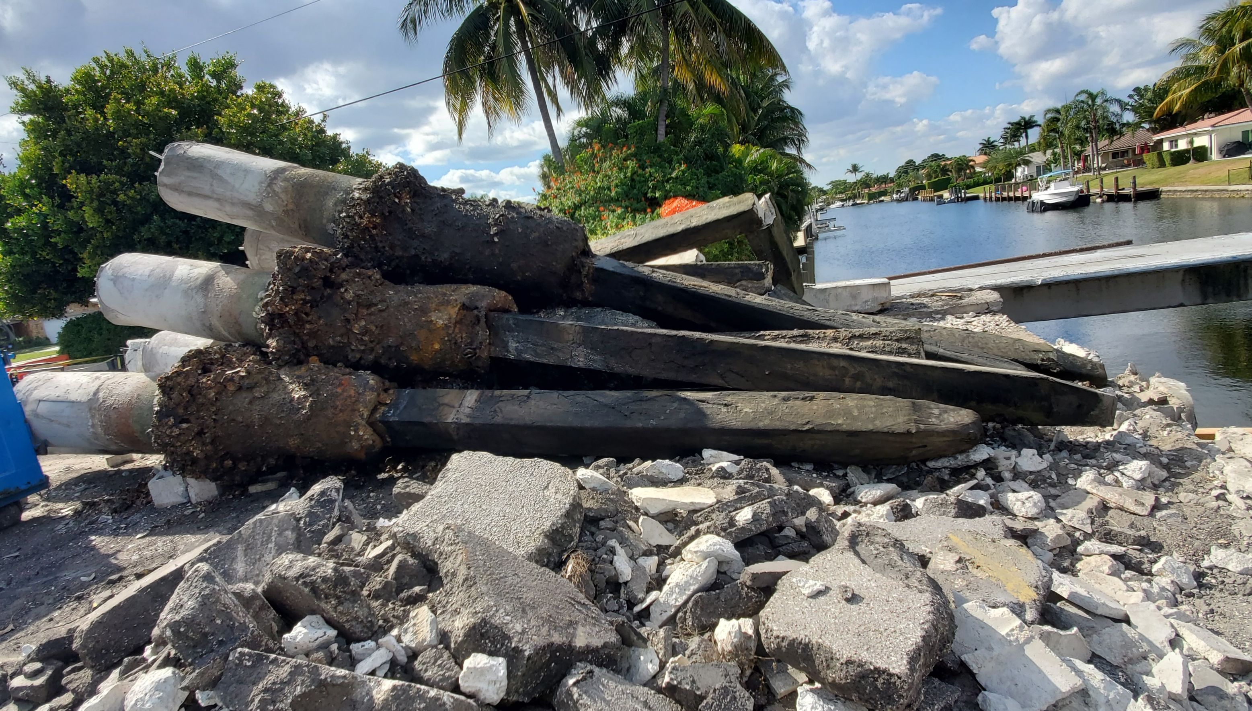
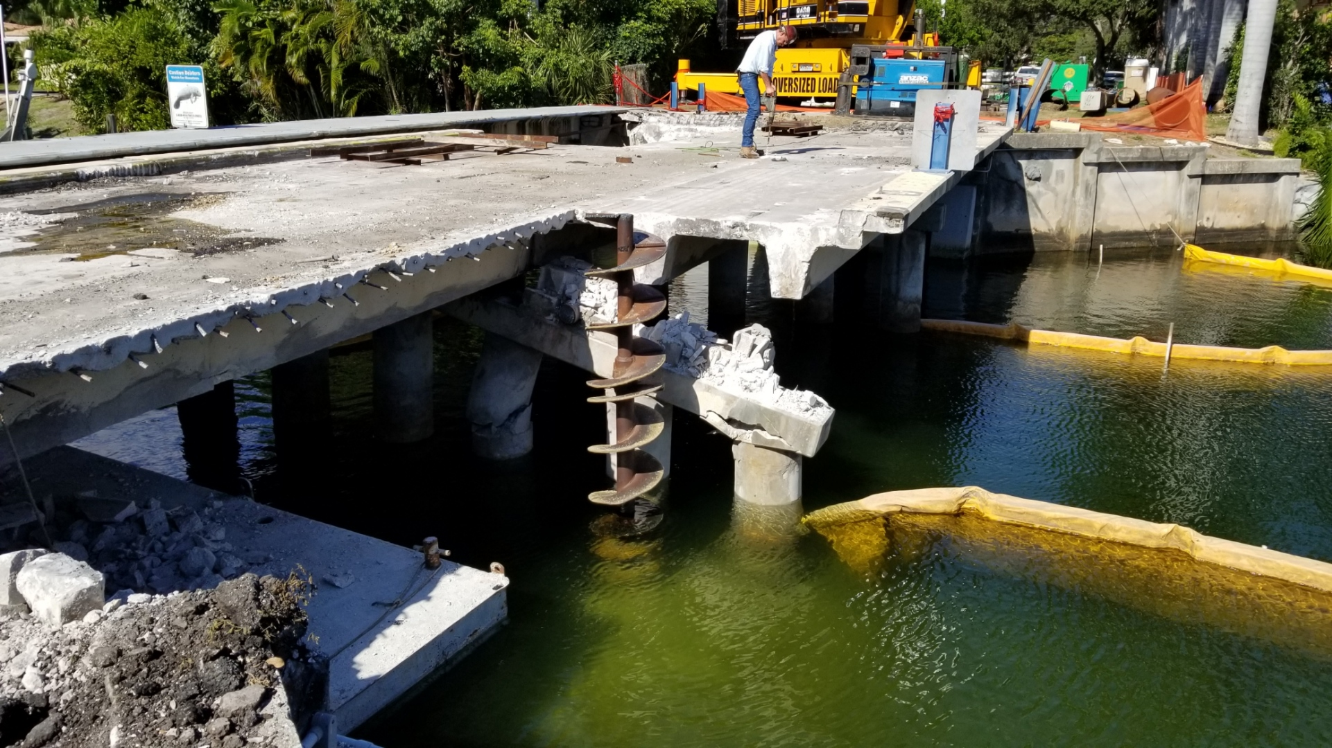
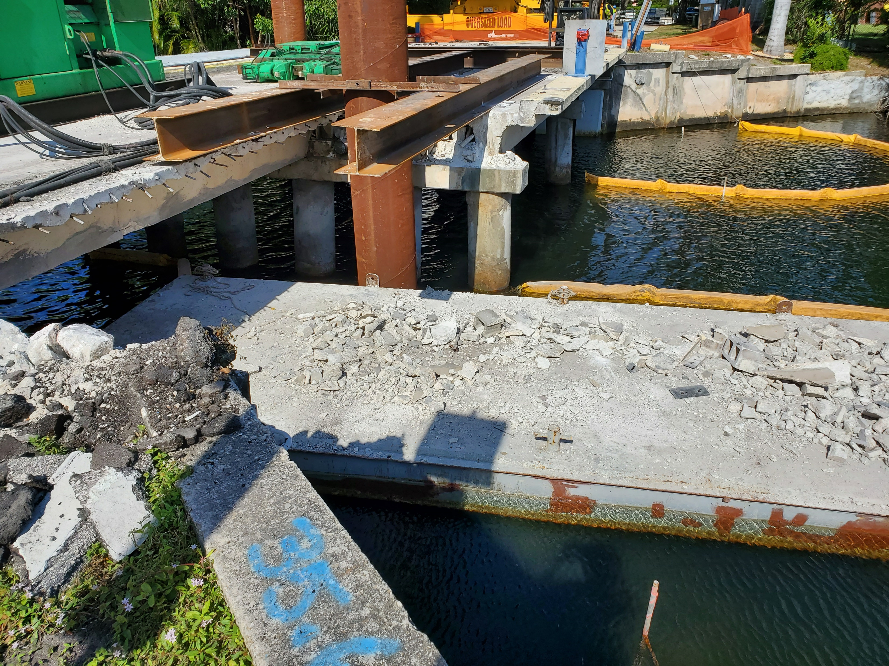
Why a Temporary Bridge
Lighthouse Drive over Ibis Waterway
Maintain Access Through Construction

Slide 6
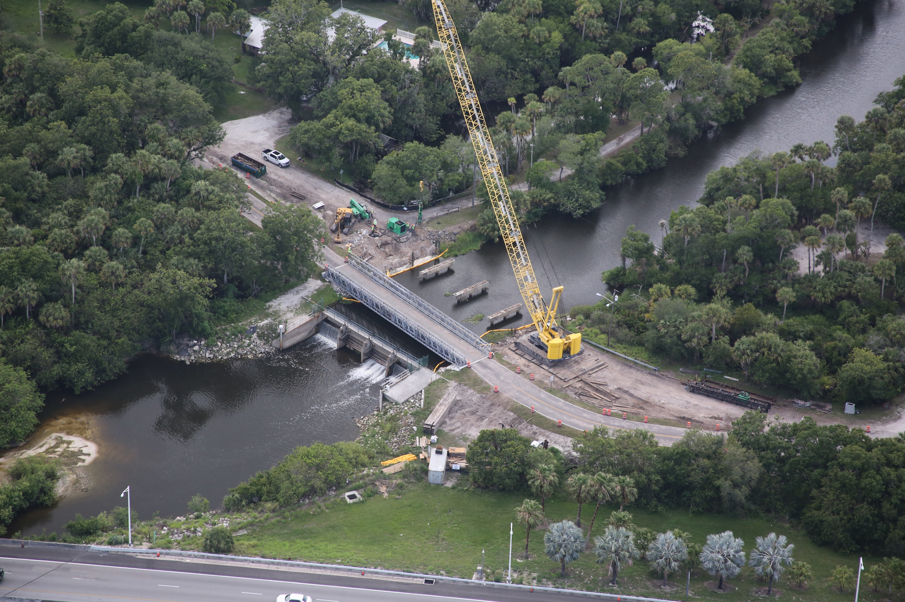
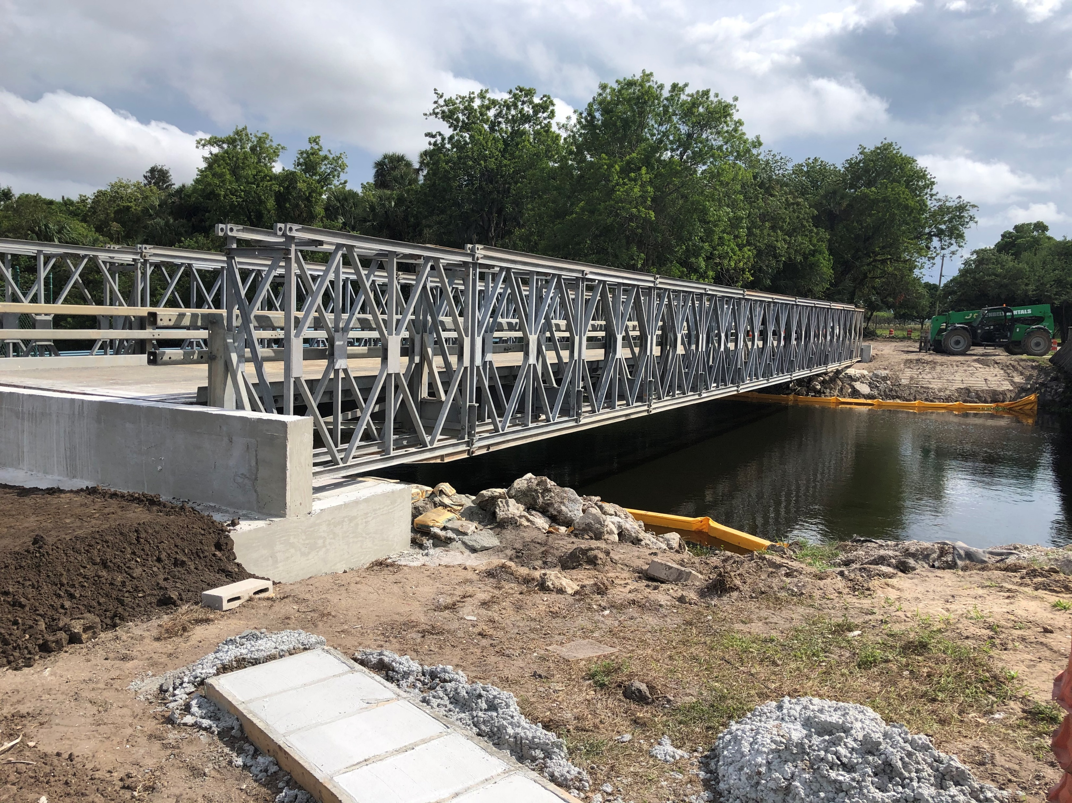
Temporary Bridge
Assembled on site
Launched into place

Slide 7
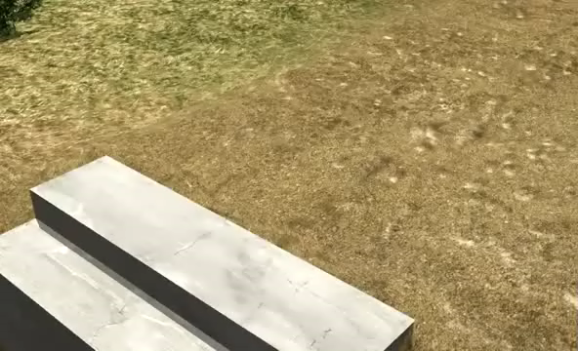
Temporary Bridge

Slide 8
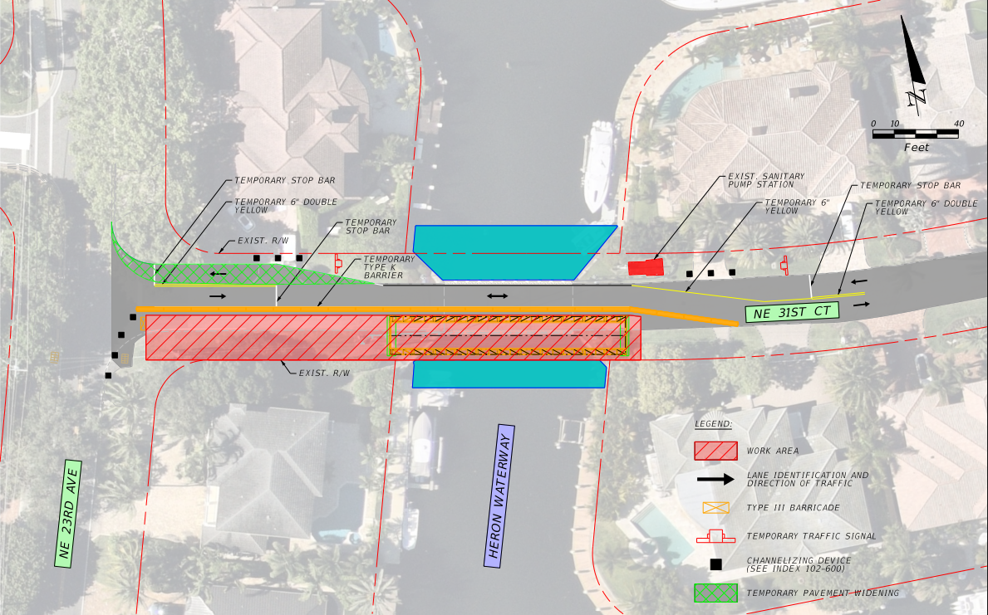
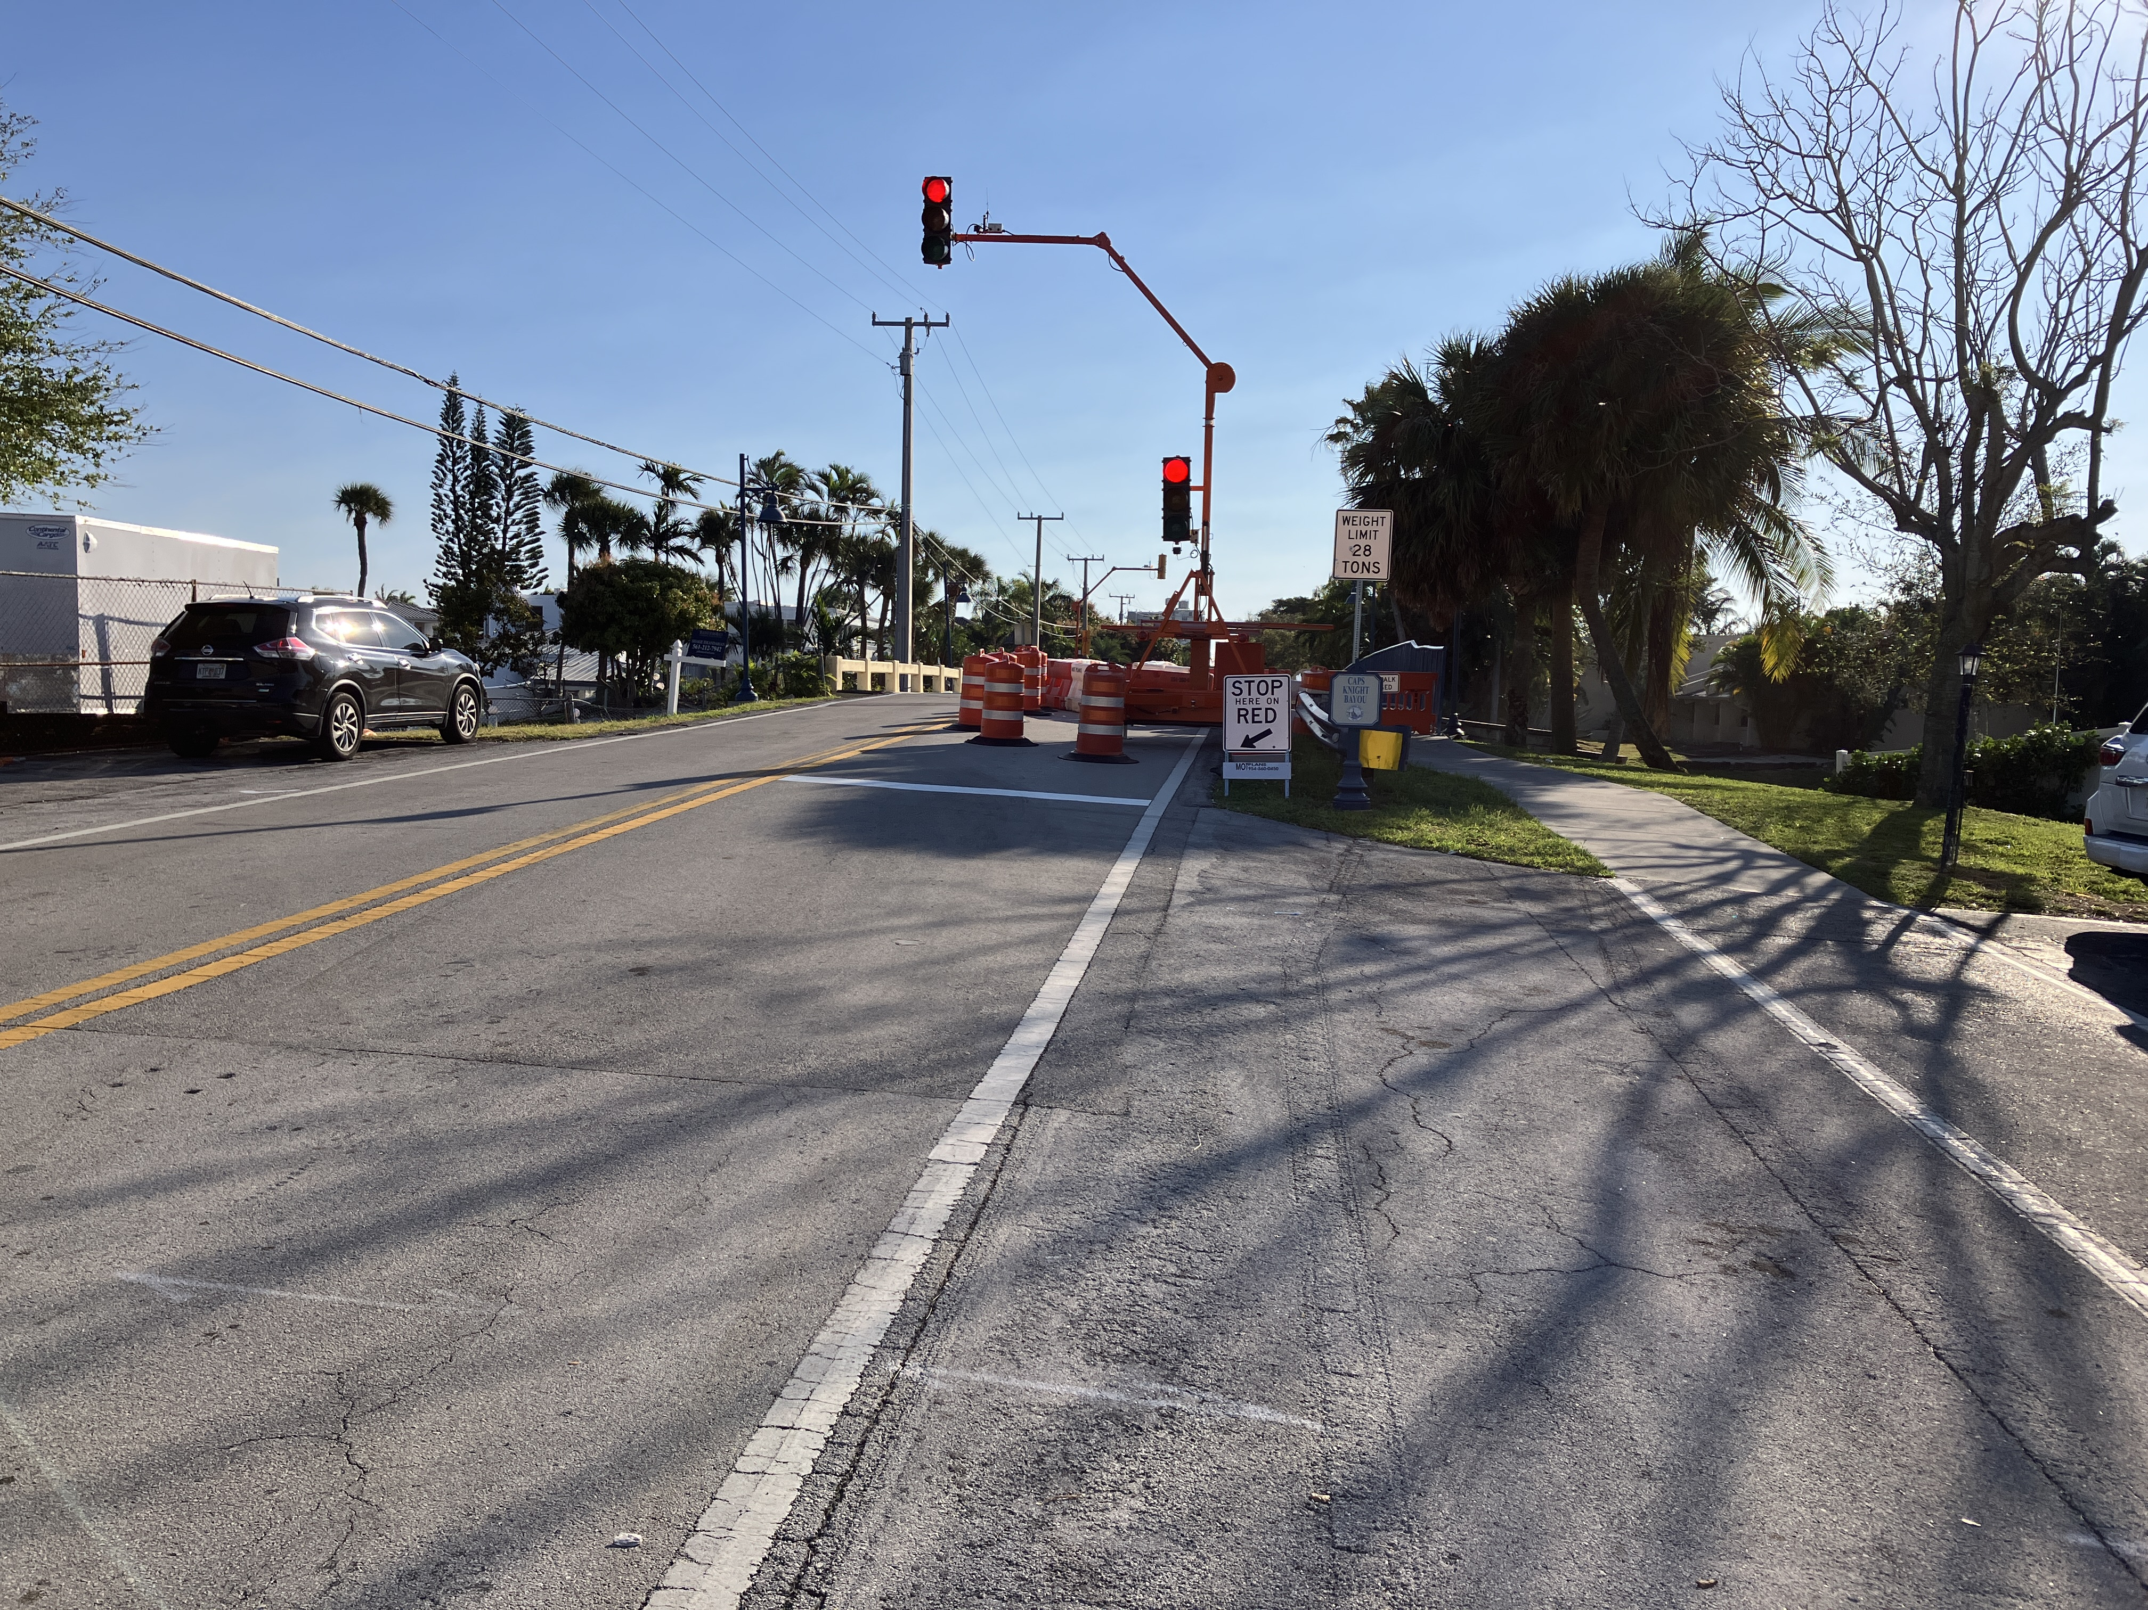
NE 31st Court – Construction Phase 1

Slide 9
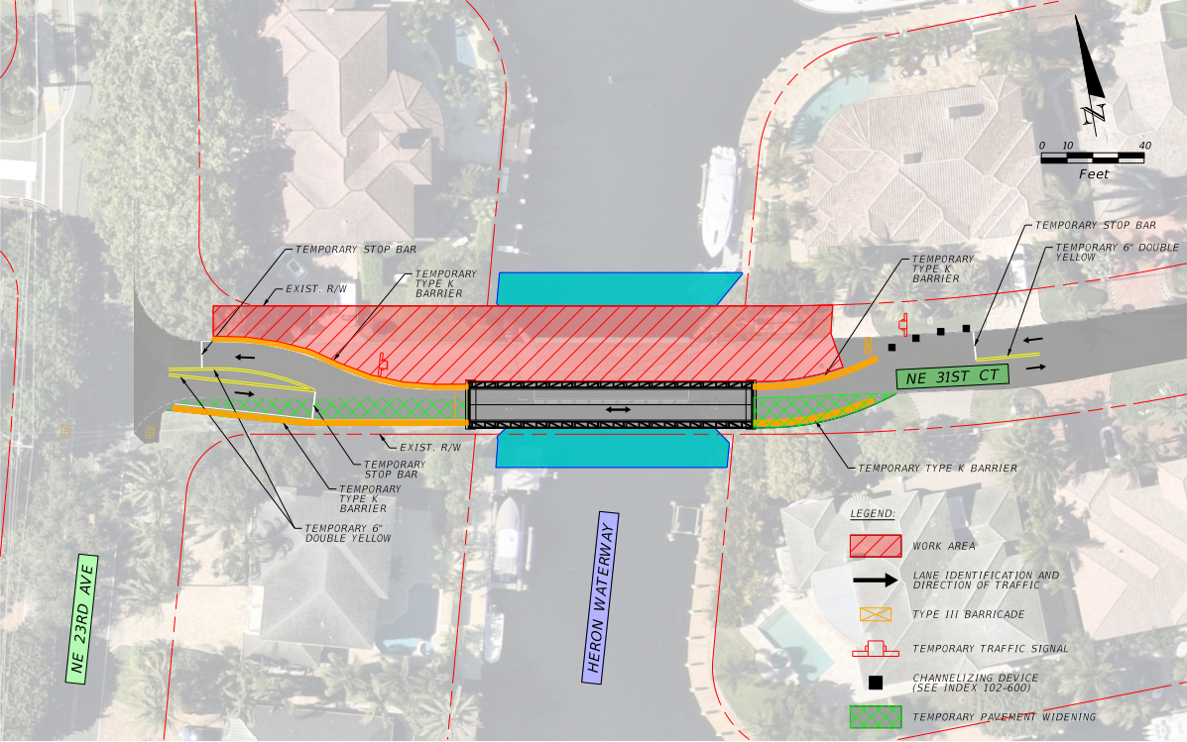
NE 31st Court – Construction Phase 2

Slide 10
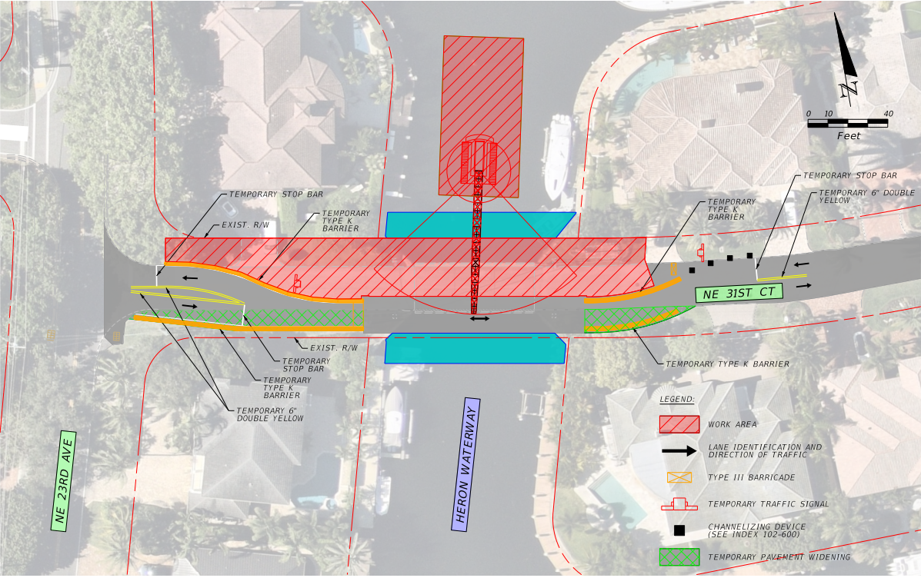
NE 31st Court – Construction Phase 2 Showing Crane on Barge

Slide 11
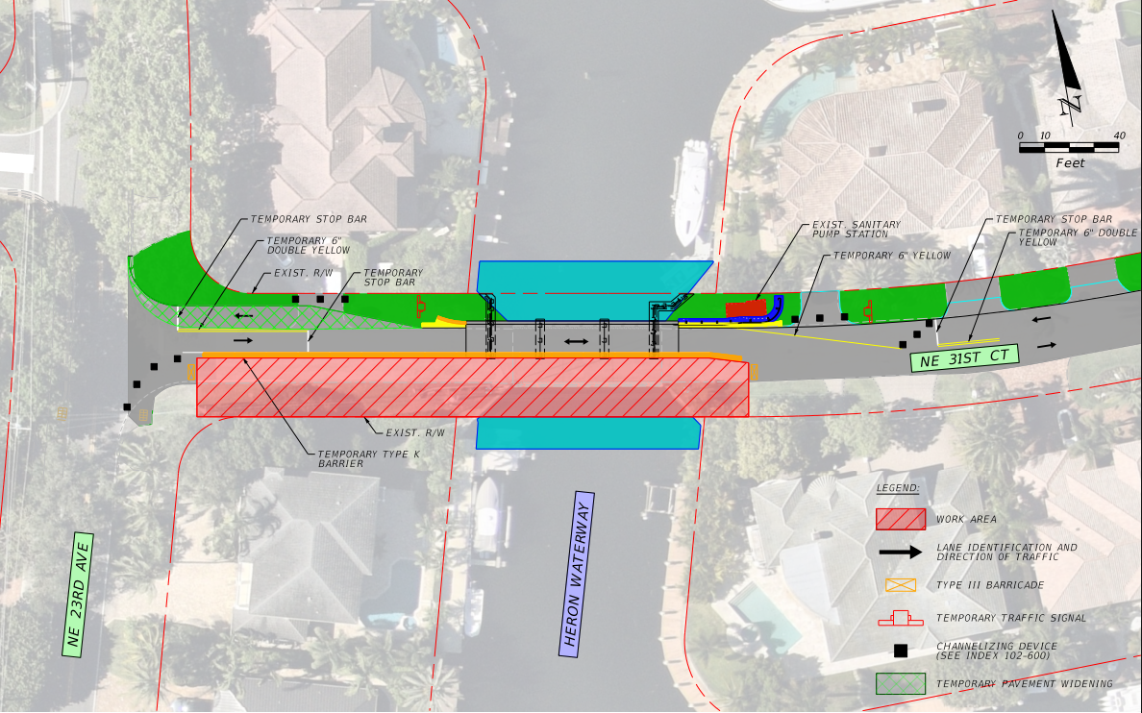
NE 31st Court – Construction Phase 3

Slide 12
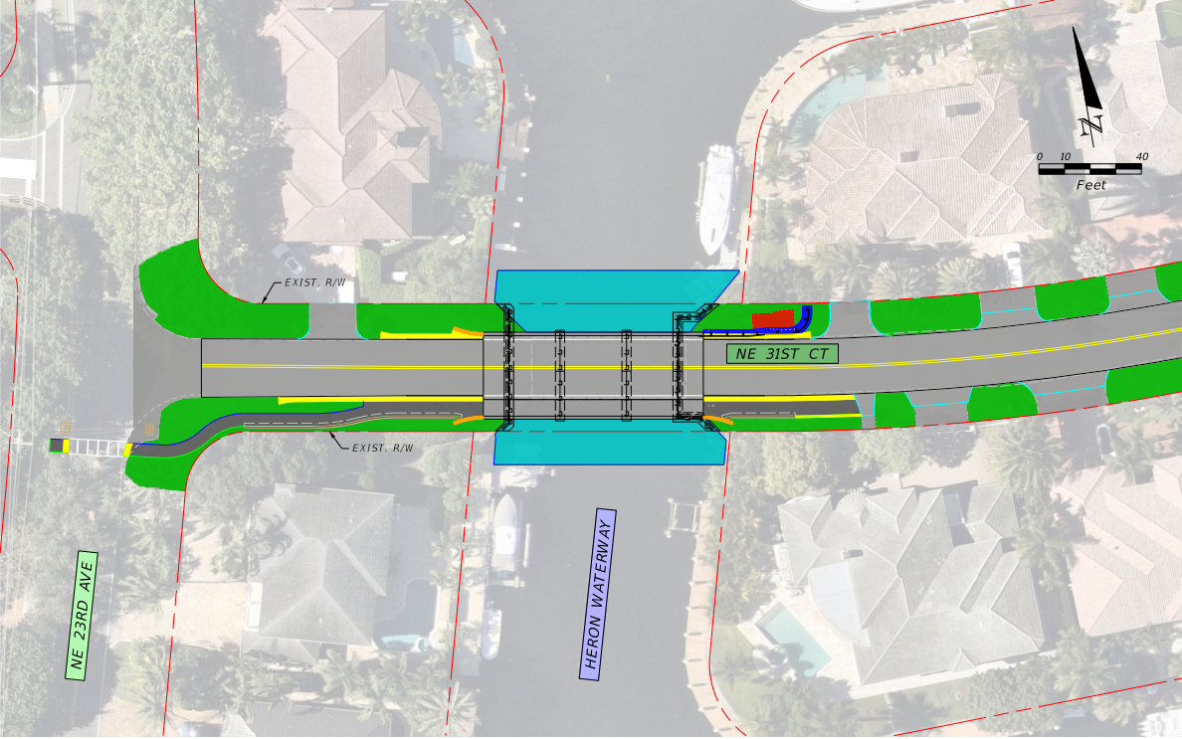
NE 31st Court – Construction Phase 4

Slide 13
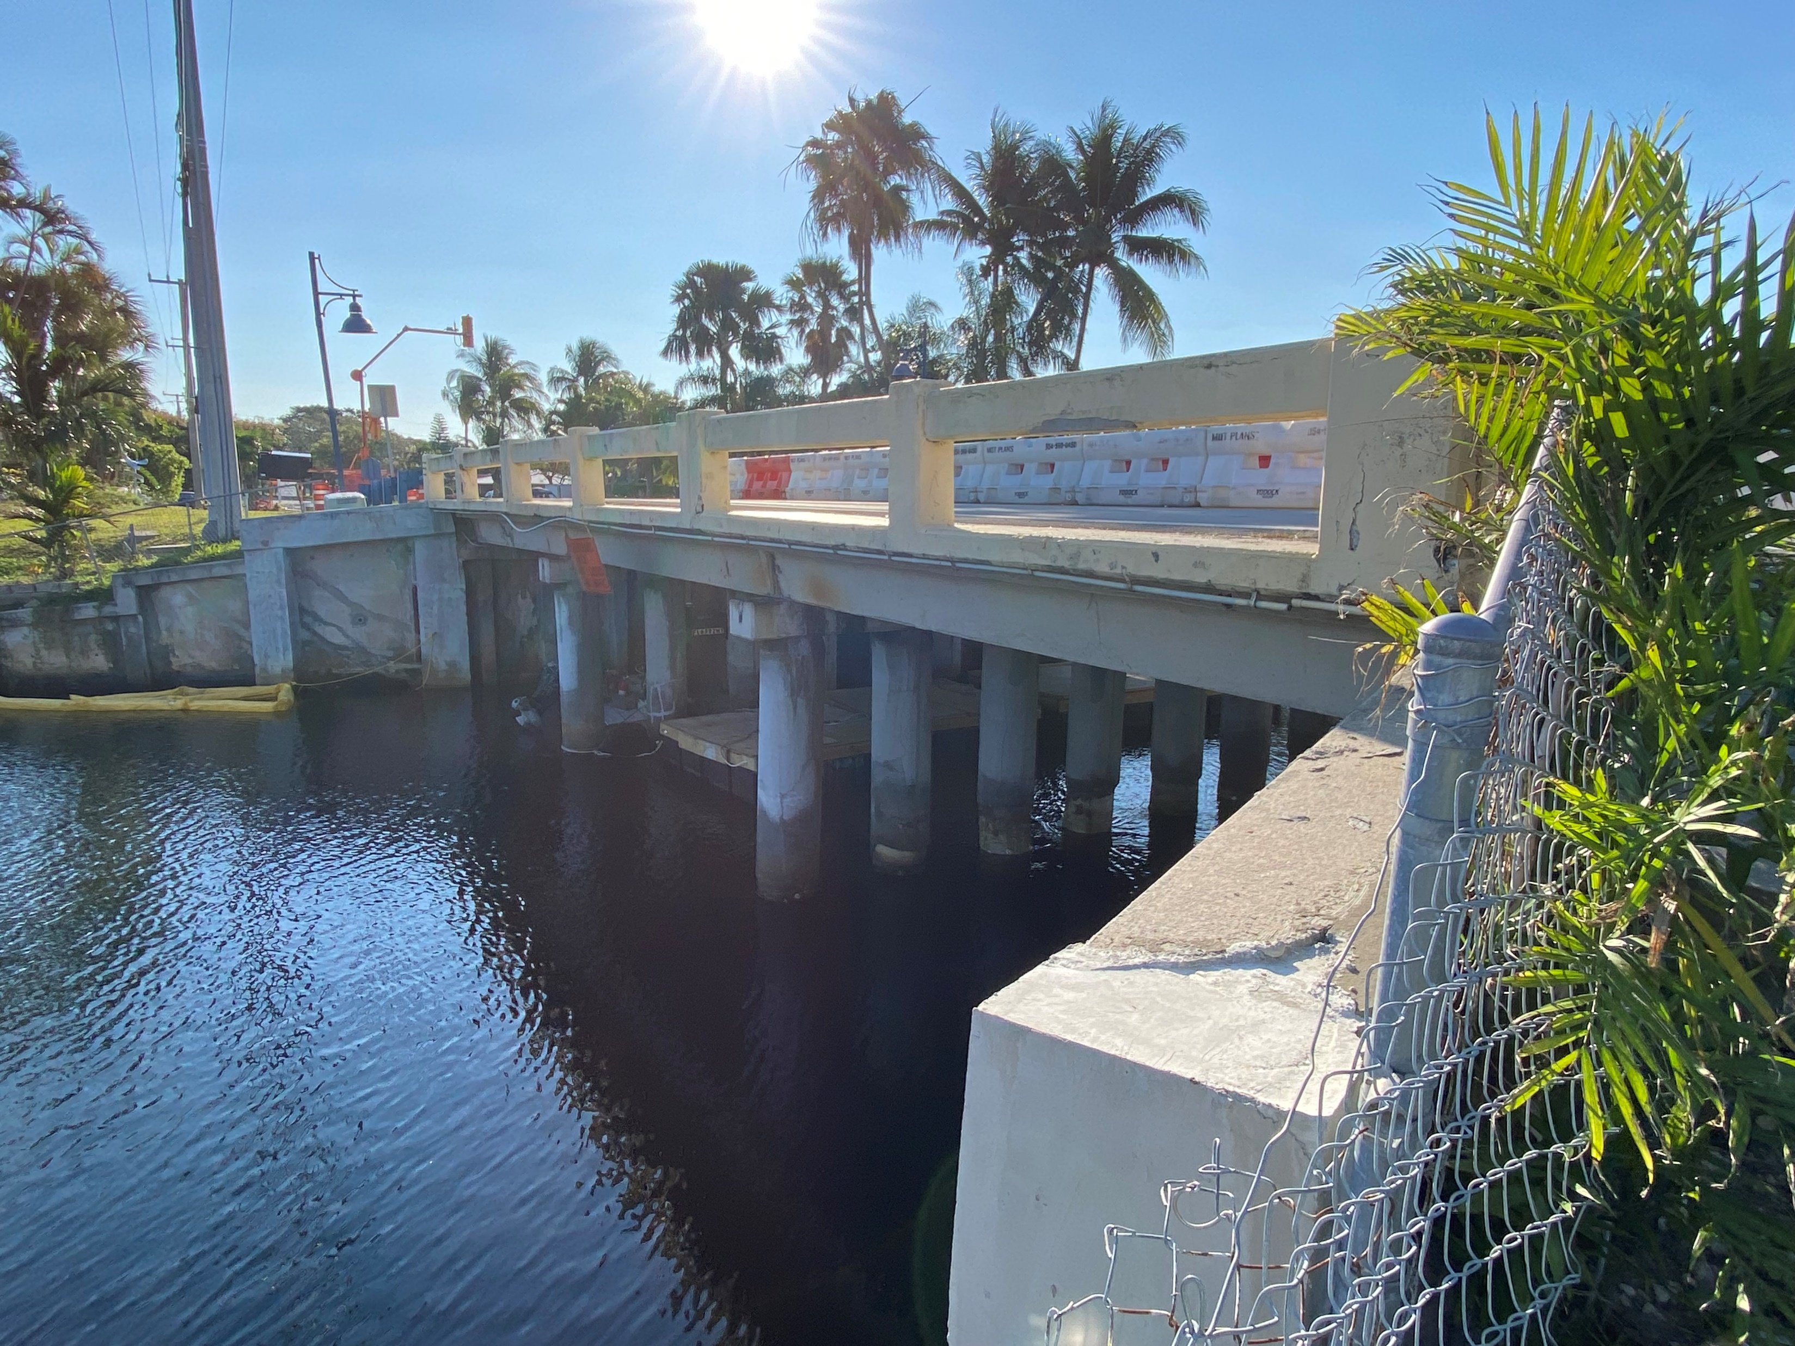
Sample Road – Design Highlights
Utilize Temporary Bridge to maintain a single lane and Pedestrian access
Connect to adjacent seawalls within City Roadway & Canal R/W
Decrease approach slope to meet ADA

Slide 14
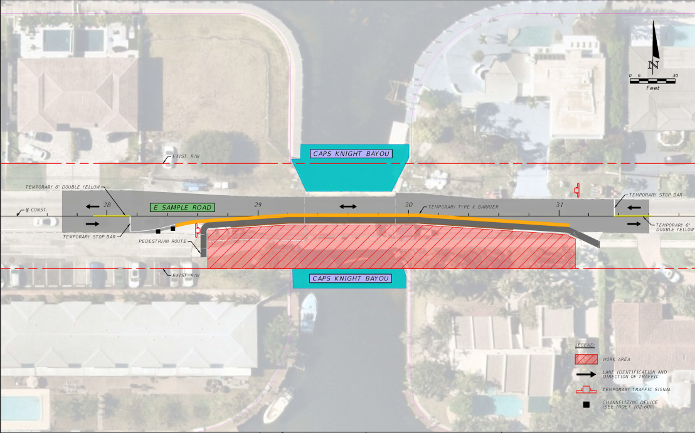
Sample Road – Construction Phase 1

Slide 15
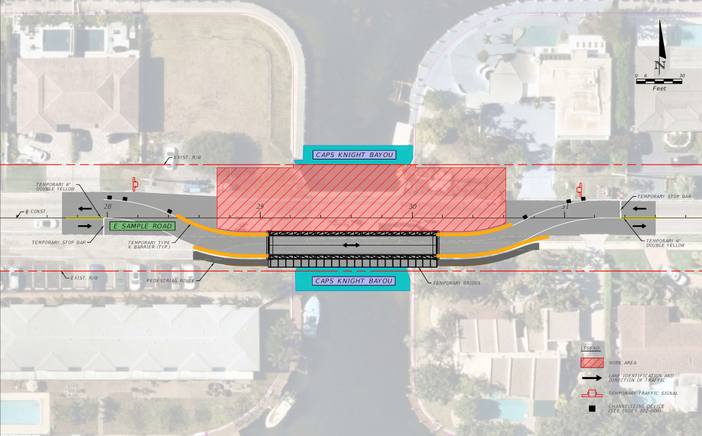
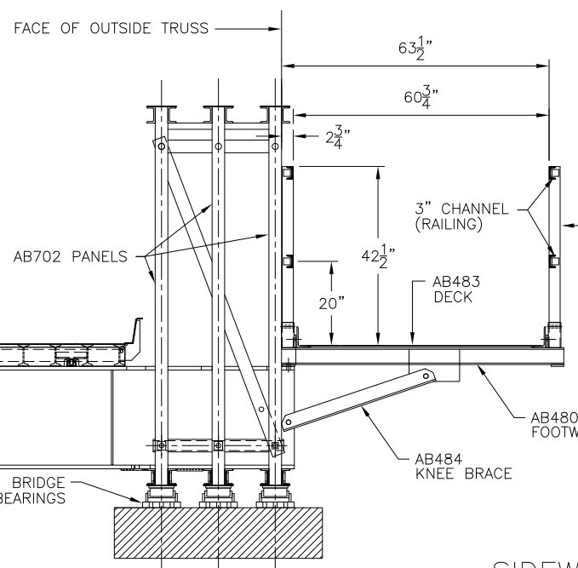
Sample Road – Construction Phase 2

Slide 16
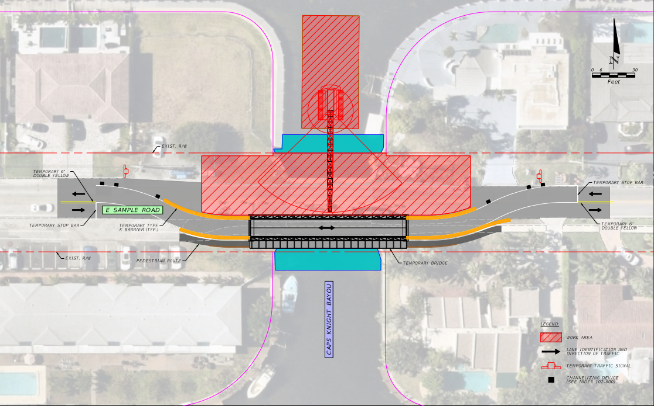
Sample Road – Construction Phase 2 Showing Crane on Barge

Slide 17
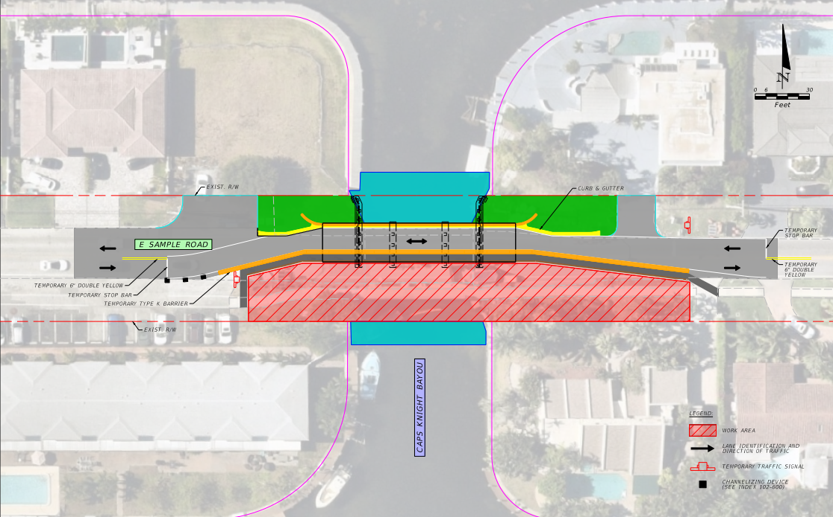
Sample Road – Construction Phase 3

Slide 18
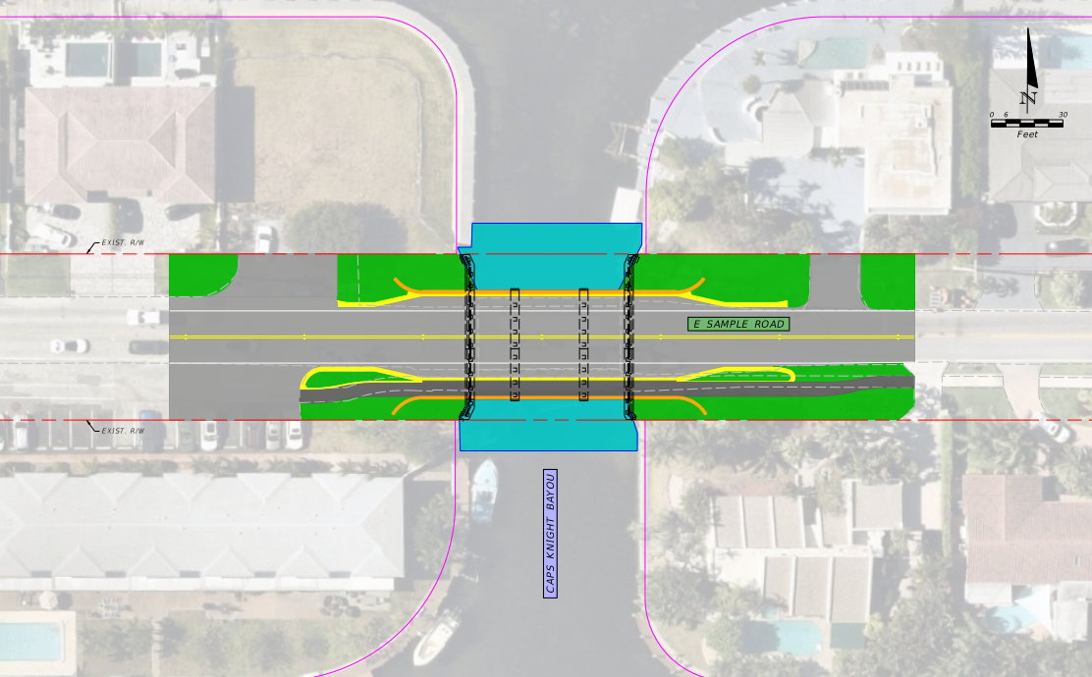
Sample Road – Construction Phase 4

Slide 19
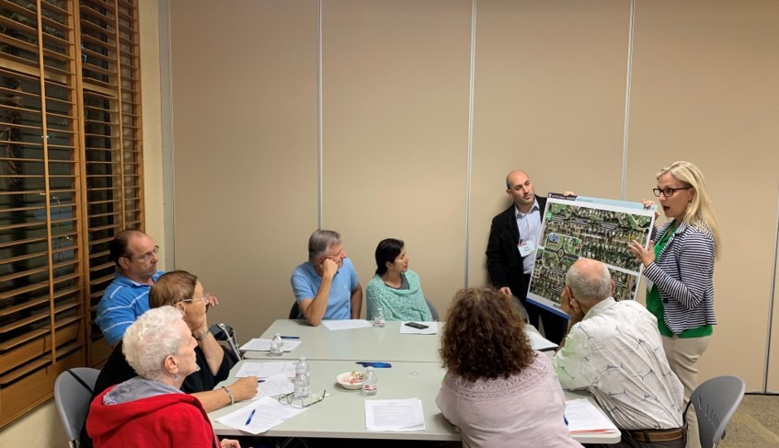
Approach to Public Outreach
Present and keep elected officials and City staff informed
Partner with City staff to meet with and inform adjacent homeowners individually
Collect input from adjacent residents
Landscaping/Irrigation on City R/W
Maintaining vessel access
Traffic Impacts
Public Outreach Meeting
Traffic Impacts
Construction noise

Slide 20
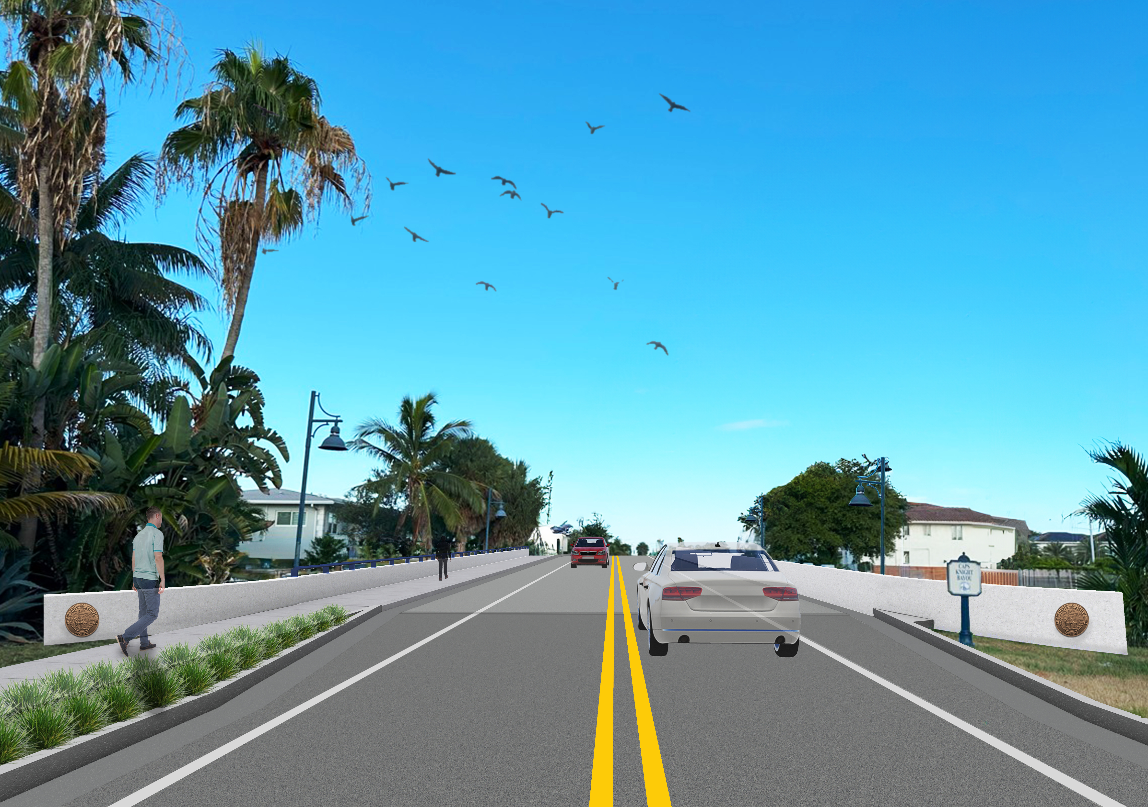
Sample Road Rendering

Slide 21
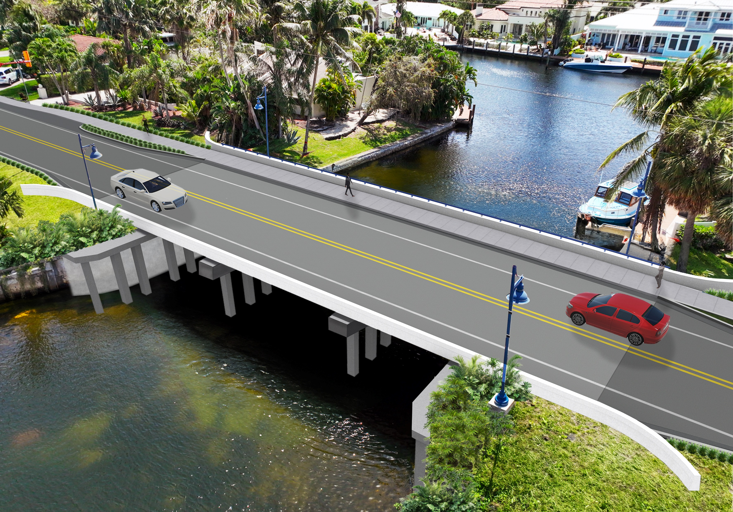
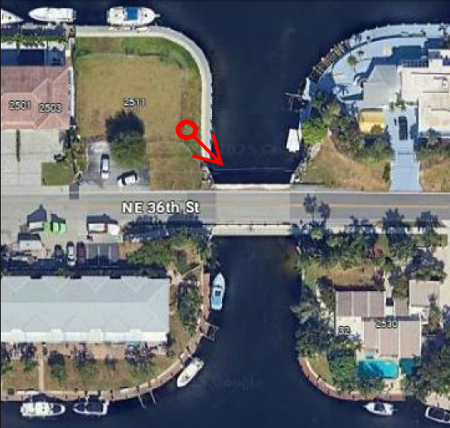
Sample Road Aerial Rendering
Looking Southeast

Slide 22

Questions?
Looking Southeast
22

