Slide 1


Slide 2
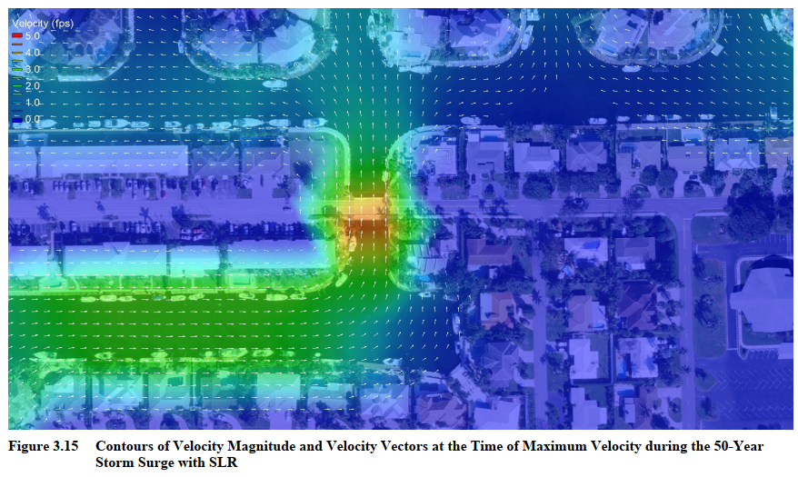
Update on Design Progress
Obtained Survey, Geotech, and utility survey
Coordinating with Utility Owners
Coordinated with US Coast Guard
Developing Construction phasing
Hydraulic Modeling Completed
Held Kickoff meeting with City Staff
Working Towards the Initial Submittal

Slide 3
Initial Design Highlights
Sample Road
US Coast Guard Permitting will not be required
Designed bridge Vertical Geometry to meet ADA without reducing clearance below
NE 31st Court
Design to avoid impacts to Sanitary Lift Station
Both bridges
Designing to avoid impacts to adjacent seawalls

Slide 4
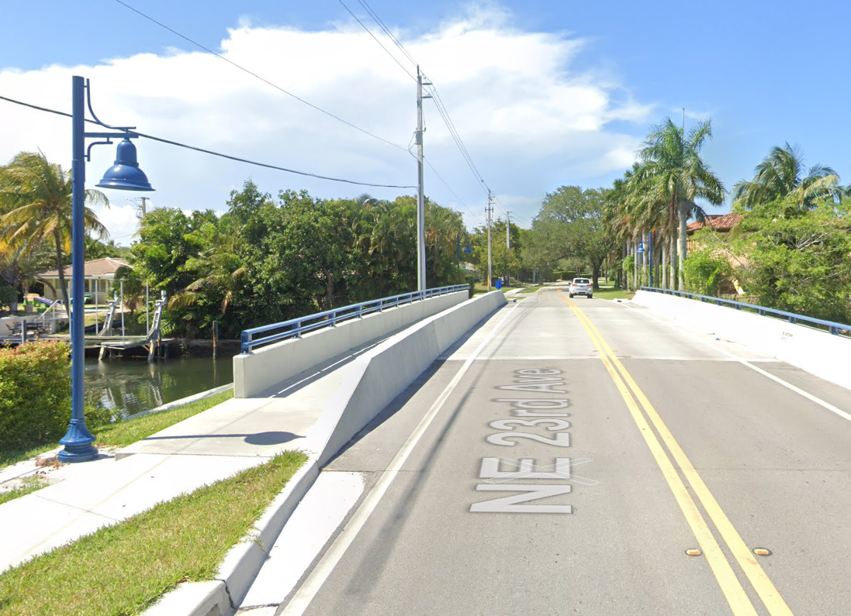
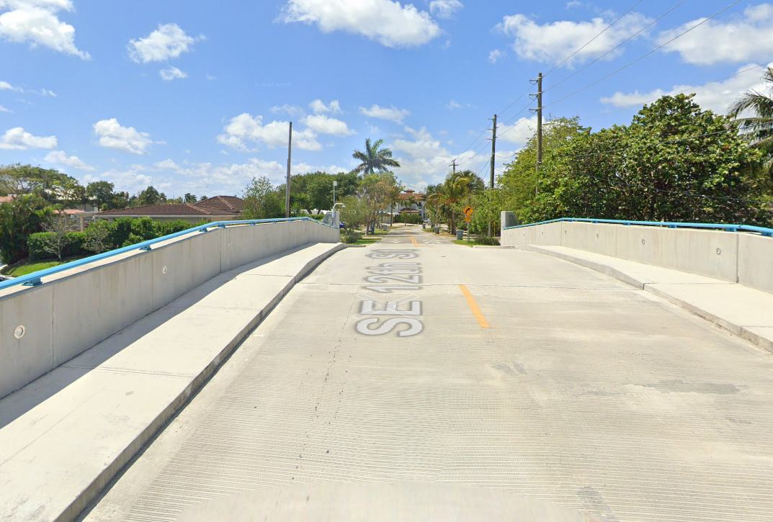
City Input – Barrier Separated VS Raised Sidewalk
Barrier Separated Sidewalk
(Lighthouse Drive)
Raised Sidewalk
(SE 5th Avenue – City of Pompano Beach)

Slide 5
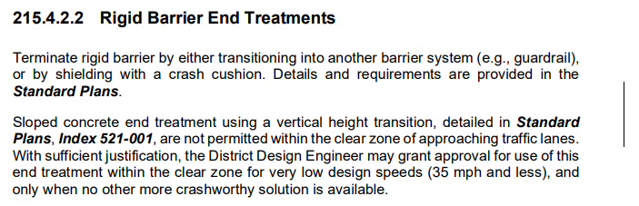
Barrier Separated
Pros
Provides pedestrians physical separation from vehicles
Cons
End Transitions require guardrail
Sub-standard guardrail
FDOT getting away from Barrier Sloped End treatments
Provides less opportunity for gateway feature
Requires wider bridge and second railing system
~$20k more as compared to raised sidewalk
More costly long-term maintenance
Overhead Utilities
Stormwater Discharge
Existing Bridge Drainage

Slide 6
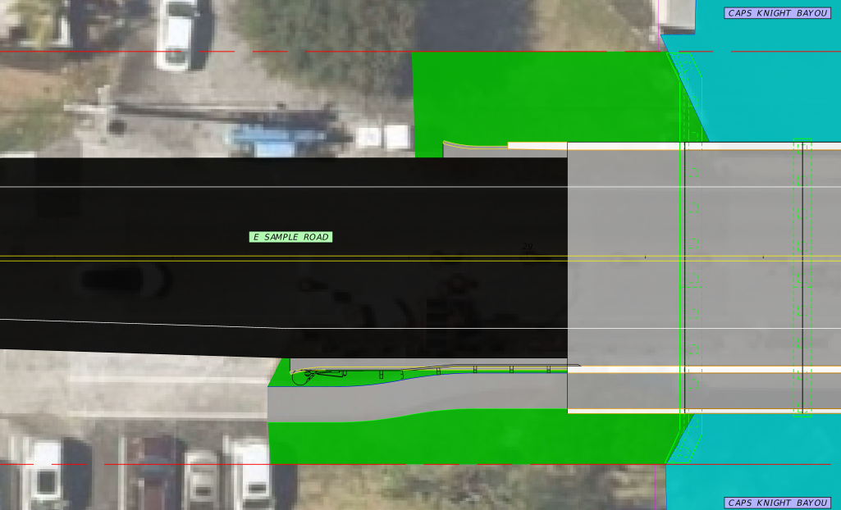
Barrier Separated - Sample Road layout
Overhead Utilities
Bike Lane
Stormwater Discharge
Bike Lane
Sidewalk
Existing Bridge Drainage
Typically seen on higher speed roads
Requires substandard guardrail
Provides less opportunity for gateway feature
Utilities and Permitting

Slide 7
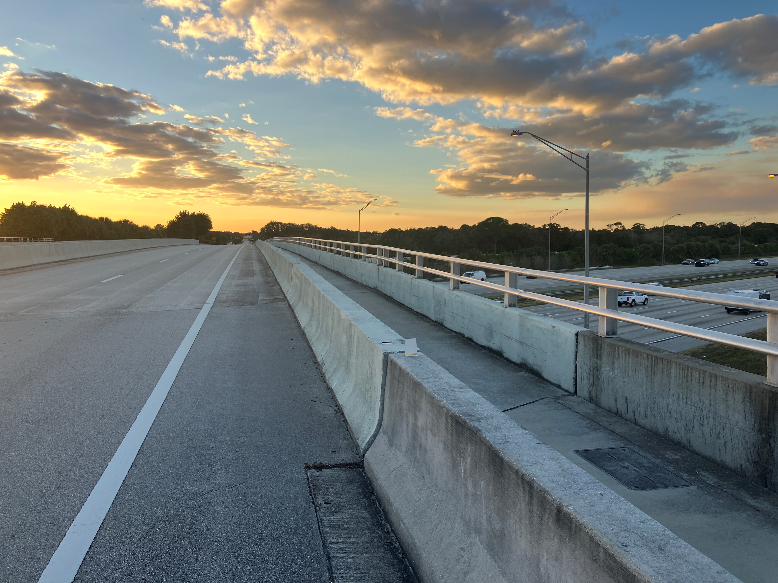
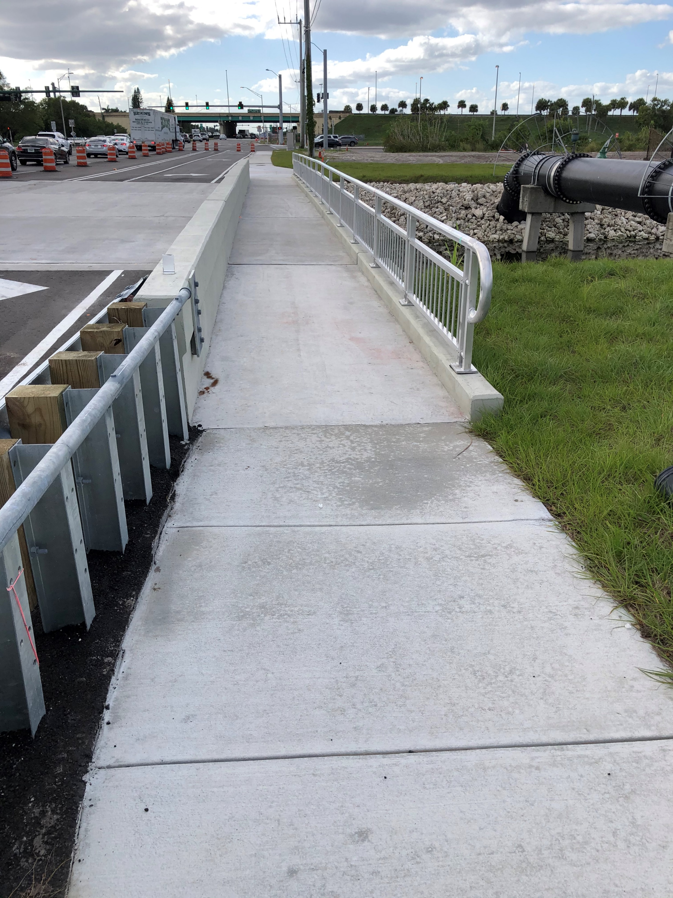
Barrier Separated – Example Pictures
Overhead Utilities
Stormwater Discharge
Existing Bridge Drainage
Hood Road over I-95 (West Palm Beach)
Atlantic Avenue (Delray Beach)

Slide 8
Raised Sidewalk
Pros
Simplified End Transitions
Flare out the Barrier walls
Guardrail not required
Provides more opportunity for gateway features
Narrower bridge with one railing
~$20k less as compared to barrier separated
Lower long-term maintenance cost
No Guardrail
Cons
Does not provide pedestrians with physical separation from vehicles
Stormwater Discharge
Existing Bridge Drainage

Slide 9
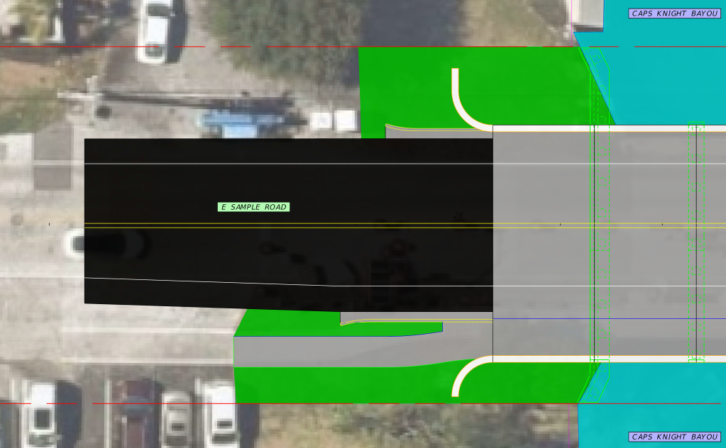
Raised Sidewalk – Sample Road layout
Bike Lane
Stormwater Discharge
Bike Lane
Sidewalk
Existing Bridge Drainage
Typically seen on low speed residential
Guardrail not required for transition
Provides opportunity for gateway feature
Utilities and Permitting

Slide 10
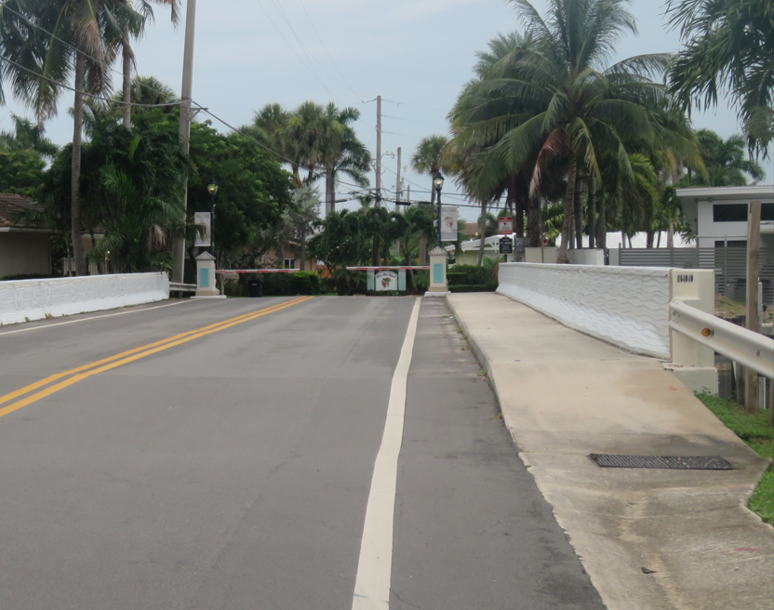
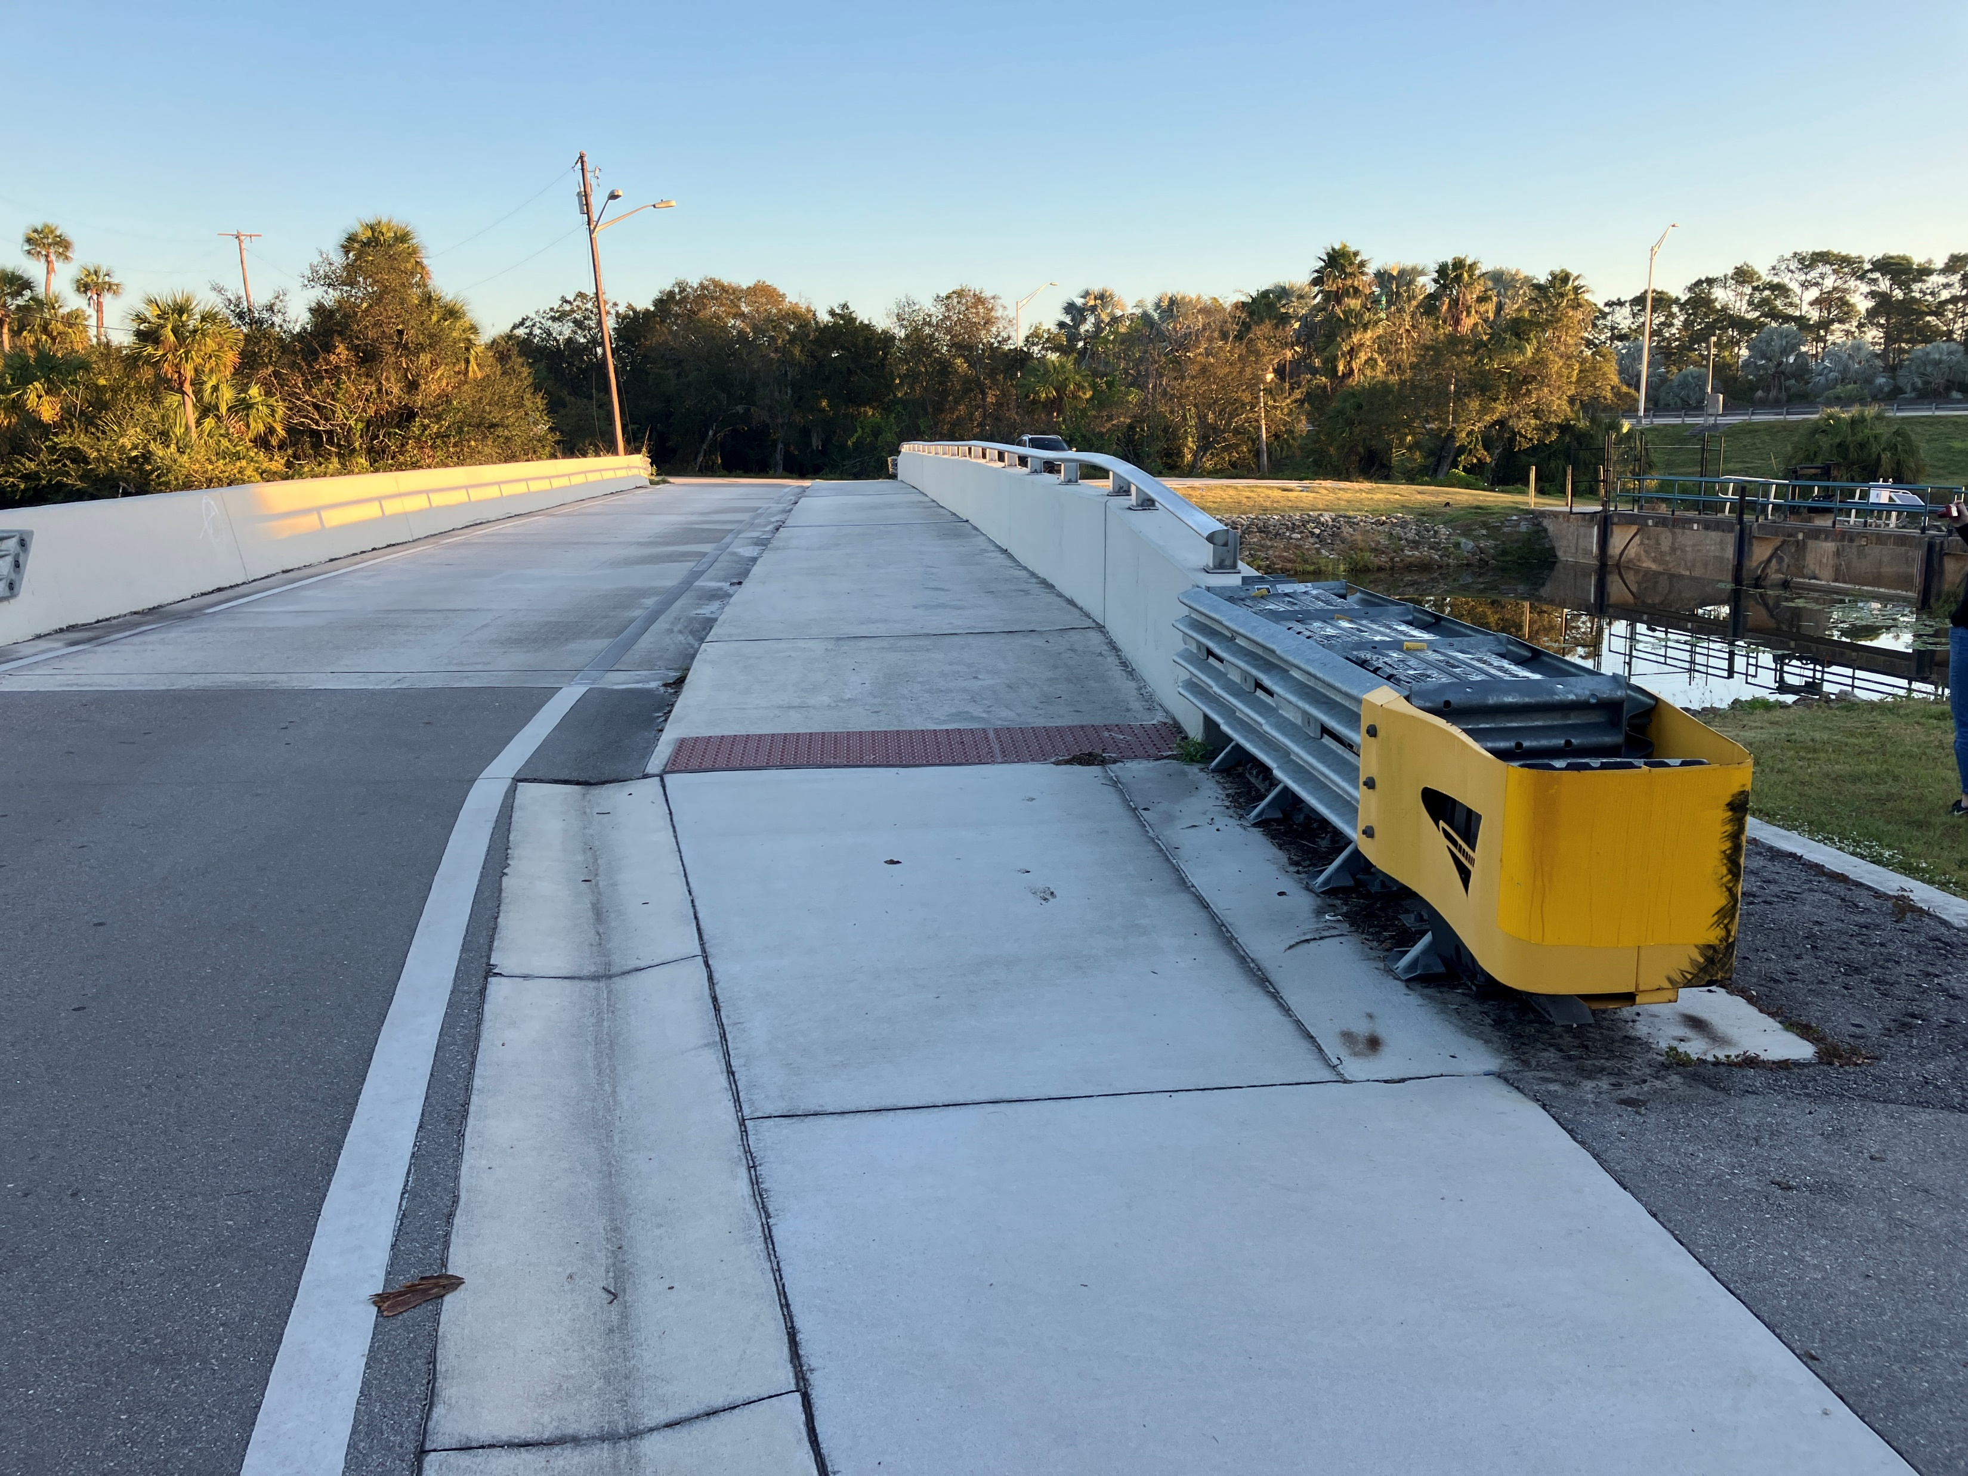
Raised Sidewalk – Example Pictures
Stormwater Discharge
Terra Mar Drive over Spanish River (Pompano Beach)
Gordy Road (Saint Lucie County)

Slide 11
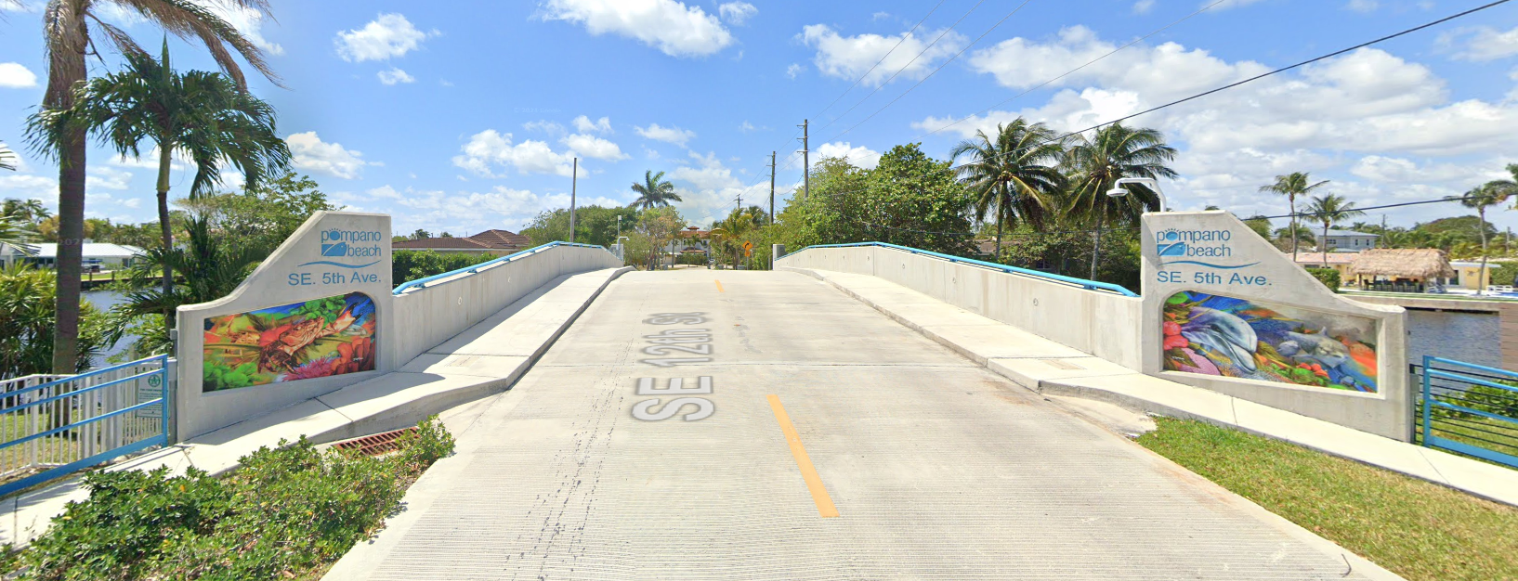
Raised Sidewalk – Gateway Feature
Stormwater Discharge
SE 5th Avenue over Pompano Canal (Pompano Beach)

Slide 12
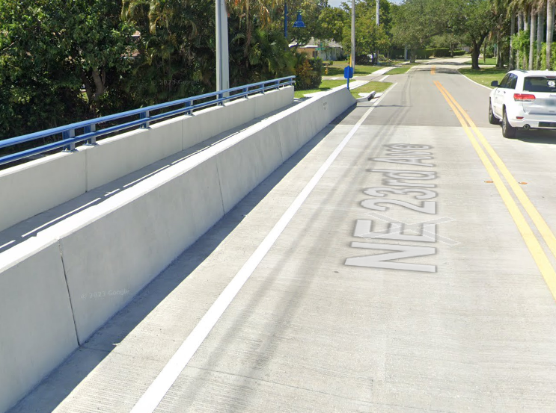
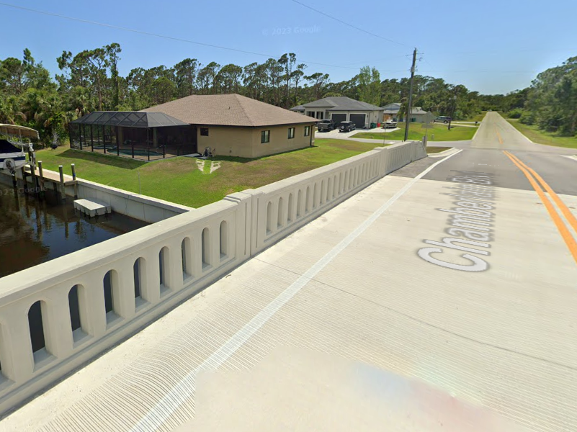
City Input - Traffic Railing Options
Standard FDOT Traffic Railing (Lighthouse Drive)
Aesthetic Texas Traffic Railing
(Charlotte County)
Both Railings are Crash Tested

Slide 13
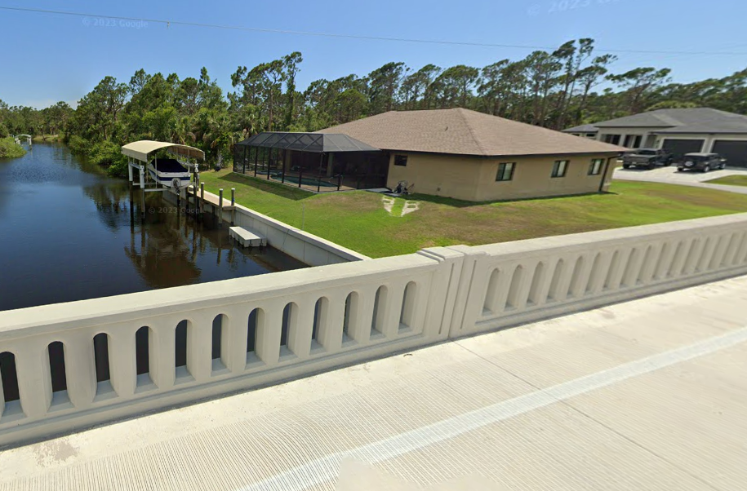
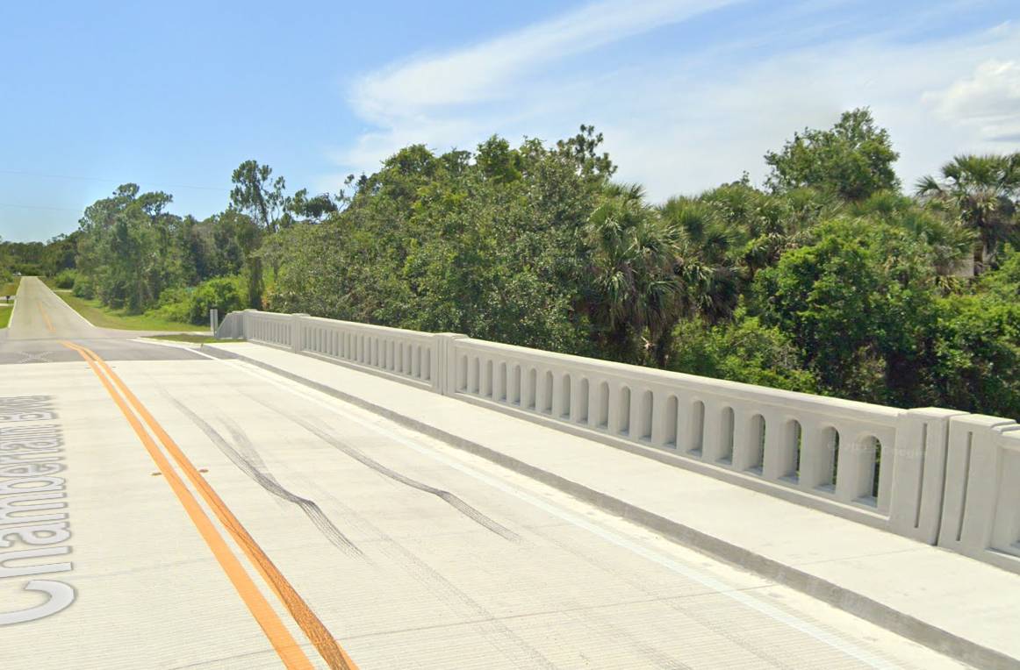
Traffic Railing Options – Aesthetic Railing
Standard Texas Traffic Railing (Chamberlain Blvd)
Railing is Crash Tested
~ $30k Increase as compared to FDOT Railing
NE 24th Avenue Bridge Considerations

Slide 14

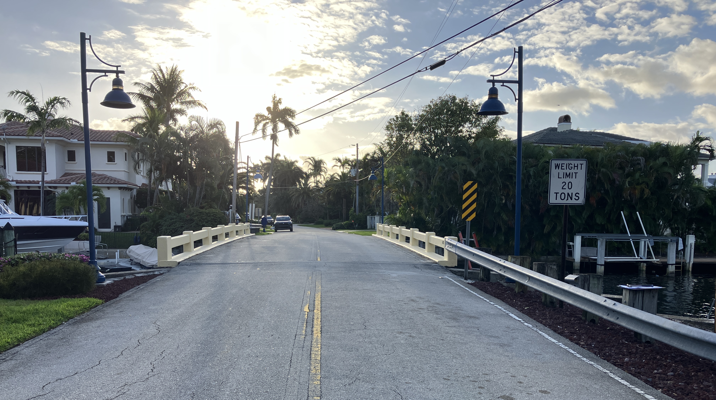
Questions?
Requested Input from Commission
Barrier Separated vs Raised Sidewalk
FDOT Railing vs Texas Railing
14

